Slide 1
QA&Test Embedded 2021 Test Management
Modern Embedding Testing
Daniel Charles Chittenden
Senior Test Consultant at Q -Nation
Oct 20th 2021

Slide 2
Agenda
About me
What is a Monolithic embedded system?
Why?
importance of optimizing / modernizing testing
How?
Challenges
Strategy & Initiatives
Applying it!
Test Reporting with Big Data / Cloud data

Slide 3
The bit about me…
Daniel Charles Chittenden
Canadian, 51
Living in Denmark
Works at Q Nation – Senior Test Consultant
Background as B.Sc.E.E
+20 years in software development
15 years in software testing and embedded systems
Working in all aspects of software development with a major focus and passion for quality and test.
Using agile techniques and test design techniques

Slide 4
What is a Monolithic Kernel?
An operating system architecture for a particular platform that includes all OS functions such as the file system, virtual memory manager, application interprocess communication and drivers.
A relatively large kernel with sophisticated capabilities that can be suited for an embedded environment
Ease of productivity - gives programmers and testers an environment similar to a desktop operating system like Linux or Microsoft Windows
More expensive and complex - requires considerably more hardware resources and complex.
Examples of embedded monolithic kernels are embedded Linux, VXWorks and Windows CE.

Slide 5
What is a Monolithic Kernel?
Increasing in popularity, more powerful embedded devices such as wireless routers and GPS navigation systems.
Ports to common embedded chip sets are available.
They permit re-use of publicly available code for device drivers, web servers, firewalls, and other code.
Development systems can start out with broad feature-sets
Features requiring faster response than can be guaranteed can often be placed in hardware.

Slide 6
Why?
Better Consumer experience / performance
Highly competitive
Faster Time to Market
3rd party Integration complexities (Google, Spotify etc.)
Shift left testing / fail fast
Quicker feedback to developers
Closer to Consumer / End user

Slide 7
HOW?

Slide 8
Some of the Challenges
ENGAGE ALL ASPECTS OF THE CUSTOMER EXPERIENCE FOR FEED-IN TO AUTOMATION TESTING
REDUCE OVERLAP & INCREASE COVERAGE
QUICKER FEEDBACK LOOPS & RELEASES - TEST EARLY (SHIFT-LEFT)
RISK-BASED APPROACH

Slide 9
Product Maturity through testing initiatives…
Software
Development
&
UX Design
+
Integration Testing
Automation Testing
Manual Testing
Alfa Validation
VIP
Beta
1
2
3
4
5
REMEMBER!!!
The product can include…
Dashboard & Bug reporting

Slide 10
Product Maturity through testing initiatives…
Definition
- Software testing using special software tools to control the execution of tests
- Compares actual test results with predicted or expected results.
- Used to rerun mundane but important tests over and over (regression) or tests that are too difficult to perform manually.
- Runs continually, to ensure that nothing has changed since the last time (Regression - nightly)
Test cases are in control
- Is a very early beta testing group (colleagues)
- Test the combined solution (product, App and cloud) in a real environment
- It provides early feedback on customer experience to the developers. i.e. bugs, observations for change etc.
- In the early stages of product development before, launch and as part of the maintenance releases
- Testcafé testing is an internal in-house, user testing by a drop-by-when-available-and-test principle
The User/Customer is in control
VIP
- Is a select group of individuals from the Beta testing community that are loyal, trustworthy and dedicated, giving valuable unfiltered feedback before launch
Beta
- Allows developers and testers to evaluate the overall customer experience from users' point of view using external real customers giving honest feedback on the entire setup. As part of the initial launch
The Customer is in control
Automation Testing
Functional
- Ensures MVP features are performing to specs
- Write test cases first and later proceed with test execution.
- Used to verify requirements and MVP to specs.
Test cases are in control
Pre-Cert
- Ensures the full solution is tested up against the certification requirements from our 3rd. Party integration partners. i.e. Voice (Google, Alexa etc.), - - Tests executed manually, semi & full automated.
- Reports are prerequisites to SW-compliance
Test cases / partners are in control
Exploratory
- Is all about discovery, investigation, and learning.
- Test cases are not created in advance
- Test the system on the fly e.g. Mind-mapping tech.
- The focus of exploratory testing is more on testing as a "thinking" activity.
The Tester/User is in control
Manual Testing
Customer Validation
VIP
Beta
10

Slide 11
Test Complexity, Loops & Coverage
Test Loops
Testing Complexity
3rd Party devices & services
Product Family
DUT
Unit & Integration Test
<1 hr
Integration, Functional and System Test
12hr/Nightly
System and UI/UX Manual Testing
~5-7d
DUT – Device Under Test

Slide 12
Risk Assessed for Reduced Test Coverage
Endless possibilities and permutations
Effort to reduce these possibilities by overlapping market data (cloud)
Take the most common products and combine these
Feed-in from Past and Current market errors
Testing Complexity
3rd Party Devices & Services
Product Family
DUT
Reduced
Scope for testing

Slide 13
Applying the Test Initiatives
Implementing initiatives
Test steps & workflow
Decision making & Quality Release Criteria
Auto & Manual testing (HIL)

Slide 14
A suggested Test Process
RC = Release Candidate
SW Development
SW Build
Auto Regression test
Nightly Run
Test Execution Results
Dashboard
(BI)
Quality Release Criteria
Pass / Fail Rate < 5-10%
DEF Count < 1
MVP Coverage passed (Sign off)
High Risk areas covered
Market feedback included
Production Requirements
Certification pre-test
New Build
HW Development
Nightly Build
Manual Test
Pre.Cert. Test
MECH Development
YES
Regression
Daily Loop
Report Bugs
NO
Beta
Validation
Alfa Validation,
VIP etc
YES
Regression
Weekly Loop (up to 1-3 weeks long)
NO
RC?
Release
&
Beta Testing
YES
Regression
Weekly Loop (up to 3-4 weeks long)
NO

Slide 15
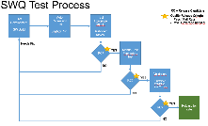
Test Process
SW Development
SW Build
Auto Regression Test
Nightly Runs
Test Execution Results
Dashboard
Tableau
All SW development:
Is built using CIS Continuous Integration Server
Runs Unit/Integration tests written by the SW developer
Runs pre system tests as smoke tests before deployment
Auto regression test execution
are triggered when a new build is received from the CIS
Run test suites that will quickly provide the first quality indicators of the complete product
Are executed each night
Consistant and Effective Regression testing
Covering as much of MVP as possible
Performance and stress testing
keeps an eye on consistency and crashes
Test Execution Results
Reporting will be primarily found as a dashboard where all can pull the latest data.
Decisions can be made on the Pass/Fail rates over time
Decisions can be made on which SW and HW Revision should go flagged for manual release release testing
CIS Continuous Integration Server

Slide 16
Test Process
Manual Test
Exploratory Test
Structured Manual testing
Executed from Test Cases in Xray
Can be systematic test steps to exploratory time boxed
Involve new ways to manual test
Picks up where the autotests have left off
Must be visible in dashboard (tableau)
Early and continual App integration testing
Pre-Production Check
Production RESTAPI / Basic functionality
Certification Pre-testing
YES
Validation
Alfa Validation, Beta, VIP etc
Validation Testing
Taking the customers experience to the limits
Using our own colleagues as very first customers
Trial runs with VIP and early Beta testers (e.g. Retailers)
Getting feedback, bugs, behaviors very quickly
Full App integration testing
YES
For Release Candidate / Nightly Build / Beta?*
Must meet Quality Release Criteria for each of the gates
DEFECT COUNT levels (<1)
Depending on the gate (Pass / Fail rates < 5-10%)
With waviers on the remaining
MVP Coverage passed – signoff Test Plan
High Risk areas covered
Market feedback included
Production Requirements
Certification pre-test signoff
RC?
YES
NO

Slide 17
Test Process
Staged Release to:
Production for Shops and display
Validation programme
Beta Members and extended VIP
General Availability
Customer SW updates, BTB
Release
YES

Slide 18
A suggested Test Process
RC = Release Candidate
SW Development
SW Build
Auto Regression test
Nightly Run
Test Execution Results
Dashboard
(BI)
Quality Release Criteria
Pass / Fail Rate < 5-10%
DEF Count < 1
MVP Coverage passed (Sign off)
High Risk areas covered
Market feedback included
Production Requirements
Certification pre-test
New Build
HW Development
Nightly Build
Manual Test
Pre.Cert. Test
MECH Development
YES
Regression
Daily Loop
Report Bugs
NO
Beta
Validation
Alfa Validation,
VIP etc
YES
Regression
Weekly Loop (up to 1-3 weeks long)
NO
RC?
Release
&
Beta Testing
YES
Regression
Weekly Loop (up to 3-4 weeks long)
NO

Slide 19
Auto vs Manual Test Execution Flow (HIL)
Issue Management Tool (JIRA - Xray)
Manual Tester
and
Physical Test Site
Auto Test Scripts
Manual
Test Cases
Manual Tester
and
Physical Test Site
Software Teams
Manual Tester
and
Physical Test Site
Manual Tester
and
Physical Test Site
Manual Scheduled
Software Quality Team
Physical
Test Site
Physical
Test Site
Physical
Test Site
Physical
Test Site
HW
Auto Test Framework
(Python +)
HW
HW
DUT
HW
DUT
Auto Scheduled
DUT
DUT
HIL – Hardware In the Loop

Slide 20
Test Reporting
What to show?
Auto test case development
Auto test execution results
Manual test results
Combined results categorized
How to show it?
Using Power BI / Cloud Data

Slide 21
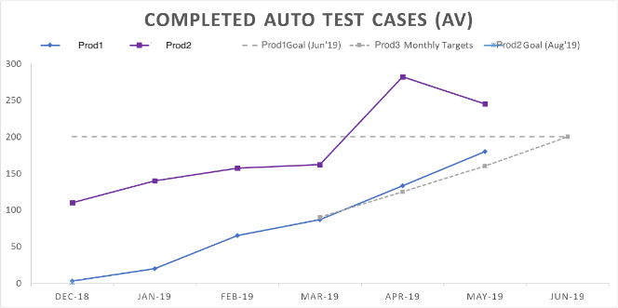
Auto Test Case Development Actual vs. Forecasted (May’xx)
Challenge:
Product1 trend for May shows planned (160) vs. Completed (180) (exceeding targets)
Continue Autotest development for Prod2, Prod3 and adding Prod4
Drop due to – old migrated test cases optimized for reuse & maintenance giving better test coverage
Risk:
New products and continuing support for meeting targets for future months (see actual vs. projected plan)
Mitigation:
Focus will be on delivering the additional Test cases continuing consultants for 2 to 3 months (2 FTEs in 3 cal. months)

Slide 22
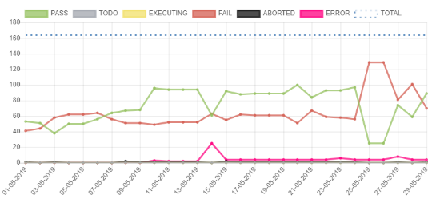
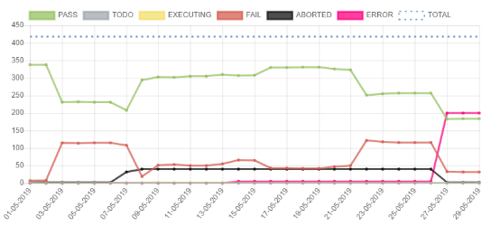
Auto Test Case Execution and Test Results (MAY’xx w22)
Continue to show an unstable trend (Pass/Fail rate >25%)
Action:
Focus needed from the SW team to secure stability of the platform
Major fail on nightly - Boot/Flash update procedure
SWQ is looking into ABORT & ERRORs
Has been stable in a long period, however recent spike HDMI tests failing due to test environment issues
Action:
DEV/Test team looking into the situation

Slide 23
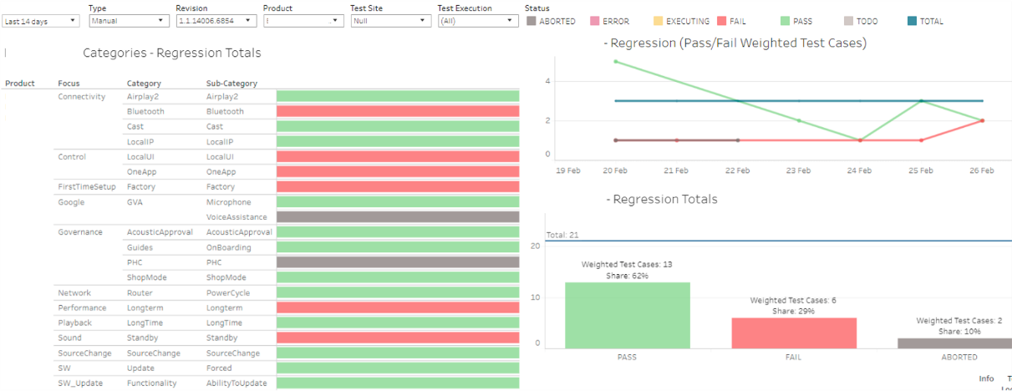
Test Report - Power BI

Slide 24
Thank you

