Slide 1

An experience report on two Risk-Based Testing and Reporting approaches -
An attempt to adopt Risk-Based testing and reporting in agile environment

Slide 2





Short Introduction
Goce Naumoski TL STI @ ASML Netherlands
20-year experience in ICT:
Test Architecture, Model Based Testing, Test Strategy, Test Management, Risk-Based Testing
Rachid Kherrazi CTO AKKA Netherlands
20-year experience in ICT:
Experience in Security Testing, Model Based Testing, Artificial Intelligence and Test Automation
Requirements Risk-Based Testing (RЯBT)
Quality attributes Risk-Based Testing (QRBT)
Comparison: similarities, differences, and conclusion

Slide 3
Agenda
Introduction
Risk-Based Testing
Risk Management Process
Requirements Based Testing
Risk-Based vs. Requirements Based
Heuristic Test Strategy Model (HTSM)
RЯBT - Requirements Risk-Based Testing
  Analyze potential risks, analyze requirements
  Quality characteristics iso:25010
  Perform appropriate testing
  Experience problems and potentialities
  Evaluate risks and requirements
  Determine QAF and rationale
Background
Development & Test process
Test approach
Quality attributes iso:25010
QRBT - Quality attributes Risk-Based Testing Analyze potential risks, analyze requirements
  Risk identification
  Risk analysis
  Risk mitigation
  Risk monitoring
  Progress reporting
Comparison: similarities, differences, and conclusion

Slide 4

Risk-Based Testing
RBT
An objective of testing is to find important problems.
A problem is the difference between the actual situation and the desired situation.
Risk is a problem that might happen
CAUSE, an event or condition
EFFECT(S), one or more effects of an event or condition
CONSEQUENCE(S), impact of an effect on product requirements
Risk-Based Testing is testing based on some model of risk
Make a prioritized list of risks
Perform testing that explores each risk
As risks evaporate and new ones emerge, adjust your test effort to stay focused on the current crop
Three simple steps from Heuristic Risk-Based Testing by James Bach
Notes:
Adjust testing effort accordingly

Slide 5
Risk Management Process
Active
Explicit
Risk Identification
Identify risks through interviews, workshops, brainstorming, exploring the product, etc.
Risk Analysis
Analyze the identified risks and determine the likelihood and impact, perform qualitative and quantitative analysis
Risk Mitigation
Design, implement, and execute tests to discover problems related to the identified risks, reduce or eliminate risks
Risk Monitoring and Reporting
Provide insight in the quality of the product and the current status of the risks
Notes:
Risk Mitigation: “execute tests” is semantically a fine point, but we should see this in relation to the Quality Assessment Factor, i.e. to what extent we have minimized the likelihood and what we have done to contain the impact. This will be clear from the risk “mitigation method” applied.
See further the ‘risk stream’.

Slide 6
Typical reasons for RBT failing in organizations
RBT
People issues
- perception of the risk
- tester mindset
- management mindset
Test team performing the risk assessment in isolation to project team
Typical risks become the “norm”
Risk register is not kept up to date
Product and project risk not treated differently
Conclusion
Risk-Based Testing is structured, applicable to different processes and approaches, but too heavy for agile methodologies.

Slide 7
Requirements Based Testing
ЯBT
Requirements Based Testing verifies that all requirements are implemented correctly
Test cases are assigned to requirements
Test coverage is measured versus requirements
Pros
Cons
A structured methodology
  Makes sure that all requirements are implemented correctly
Stable test scope through a project
Not all requirements bring risks i.e., not all requirements should be tested
Product requirements do not show all the risks
Conclusion
Requirements Based Testing is structured but not the most cost and quality efficient methodology.

Slide 8
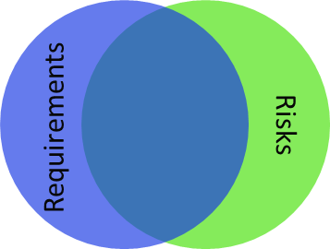
Risk-Based vs. Requirements Based
RЯBT
Structured
Efficiency
Analysis
Purpose
Benefits
Transparency
status, traceability, scope, focus
effectiveness, confidence, agility, traceability, focus
- Untestable, Expensive
Unclear, Incomplete
No backward updated
Do not show/match all risks
Unrecognized/missing
Subjective
Difficult to test
Requirements Based Testing
Risks-Based Testing
Notes:
The RЯBT approach is a Structured Testing approach that combines requirements and risk-based testing.
Summary of advantages: focus, efficiency, purpose, agility, transparency, effectiveness, confidence
IMPACT on the quality of the product → Anything that threatens quality is a risk.
QUALITY is a value to some persons who matter. (Quality is a value to a stakeholder.)
FOCUS: development > testing > business
1/ Requirements
2/ Risks
3/ Goal-based: use business goals and risk to focus testing on and support decision-making

Slide 9
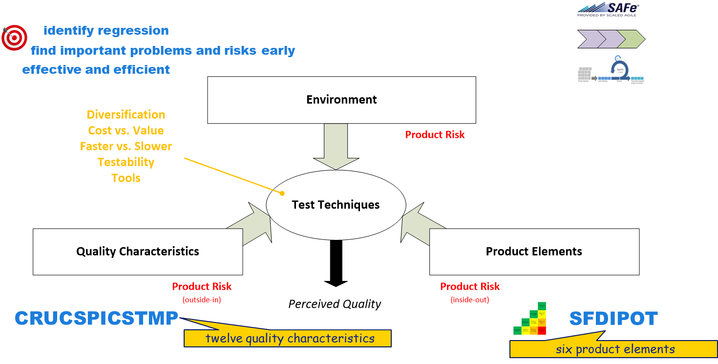
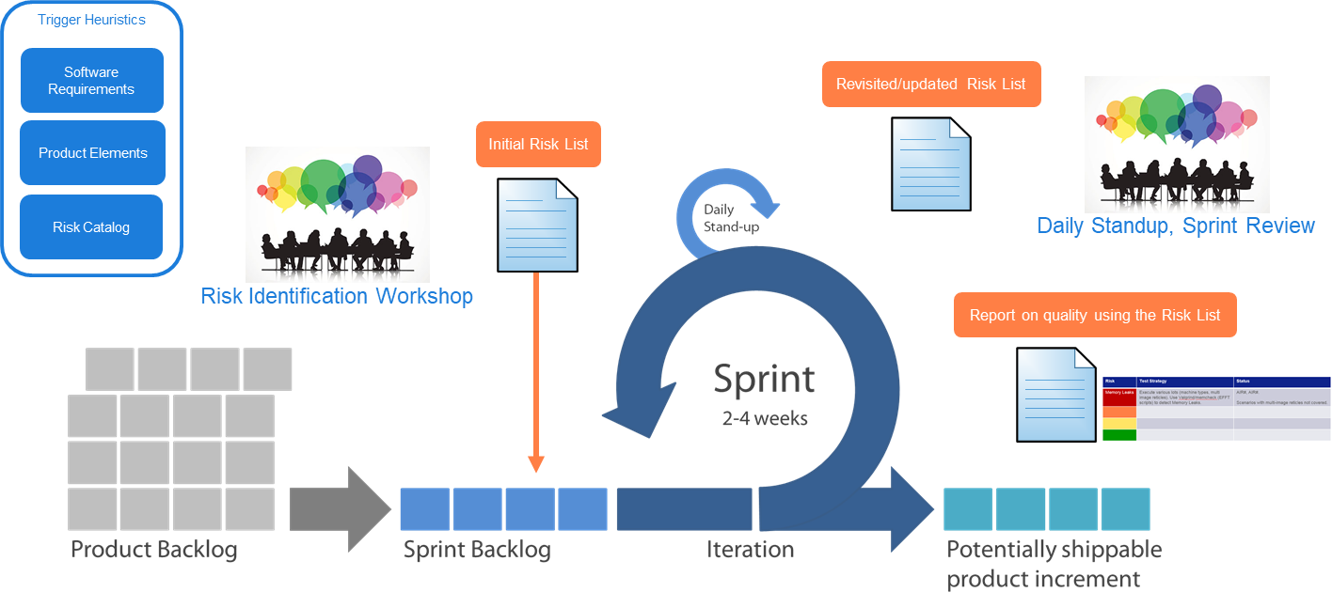
Heuristic Test Strategy Model (HTSM)
HRBT
Agile
“The Heuristic Test Strategy Model is a set of patterns for designing and choosing tests to perform. The immediate purpose of this model is to remind testers of what to think about during that process. I encourage testers to customize it to fit their own organizations and contexts.”
procedures
oracles
coverage
Inspired by the Heuristic Test Strategy Model and Heuristic Risk-Based Testing by James Bach. Details as adapted by Ruud Cox.

Slide 10
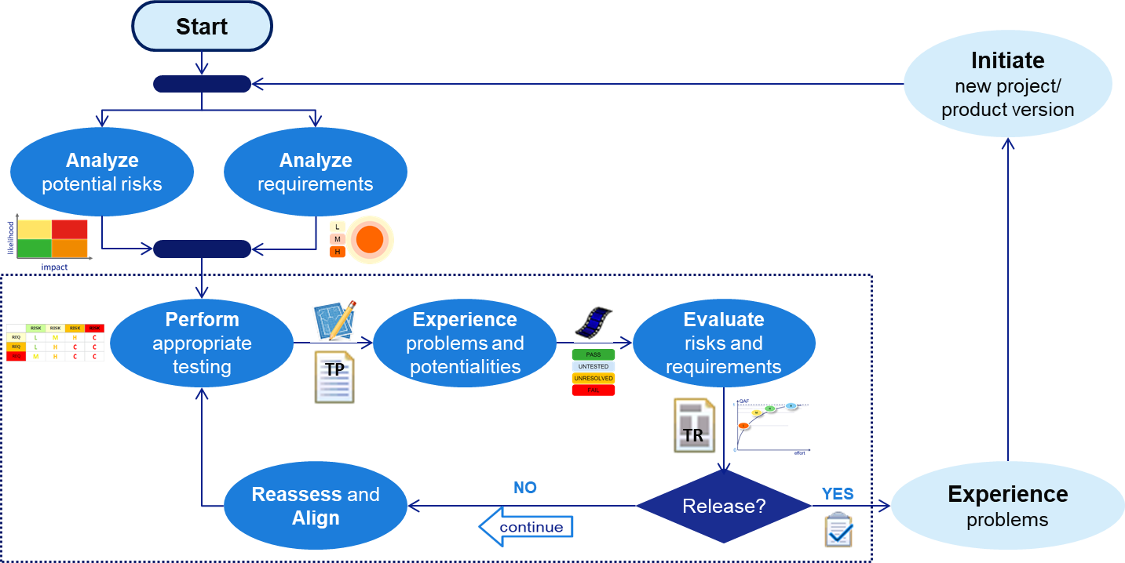
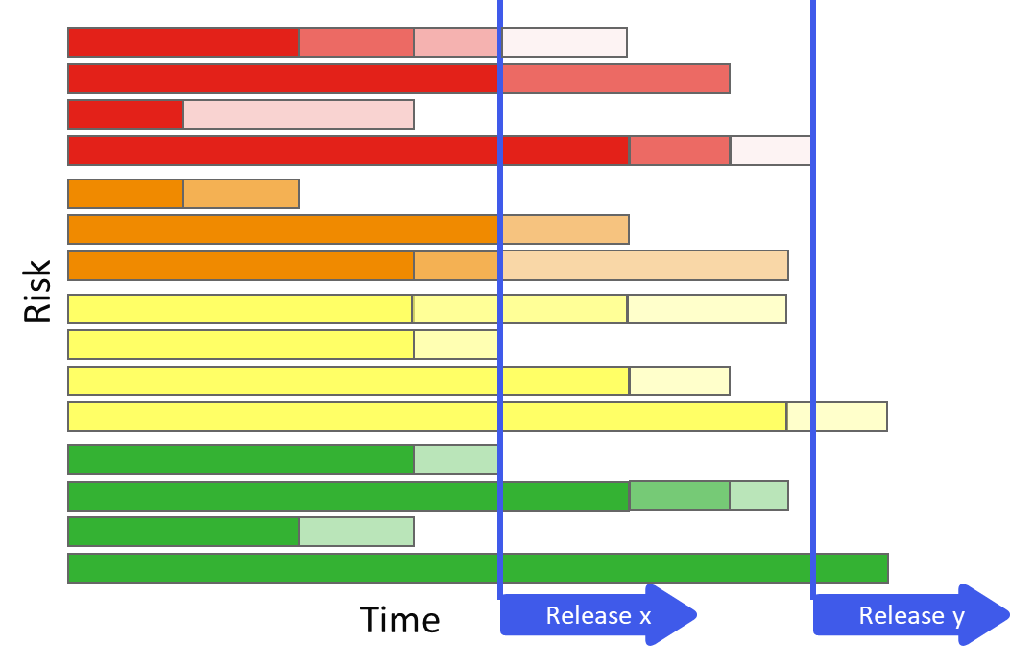
RЯBT - Requirements Risk-Based Testing
RЯBT
EPIC
SPRINT
SPRINT
For a different view on Requirements Risk-Based in agile environment see contribution by Bram Bronneberg. For an earlier presentation of the process see QA&Test 2016 by Goce Naumoski.
Notes:
The process is iterative.
Terms EPIC and SPRINT are just an example. Even in a ‘usual’ SW product development there will be some phasing.
Analysis steps are considered together. Preferably we do both analysis of potential risks as well as requirements analysis. Having no requirements to analyze should not be a problem to initiate the process, however, risk analysis is mandatory, because if the requirements are not formally written yet, we can still start executing the risk analysis and when doing that, we can consider product features and quality criteria which bring risks.
The analysis of potential risks includes the first two steps of the risk management process namely, risk identification and risk assessment.
The analysis is input for specifying and design test-cases, creating a test plan, etc. The delivery is (an update of) the TP.
When the test-cases are executed, we might experience problems and see new potentialities. The execution of the test-cases delivers results and other data, such as diagnostics and logs, which are used to evaluate the (actual) risks and evaluate requirements on the realized benefits.
A TR and a status report are created and presented to the stakeholders who, on their turn, should be able to take informed decisions about the next steps of the project.
When a decision is taken to continue, risks will be reassessed, requirements updated, and risks and requirements will be aligned. After this, a new cycle is initiated.
Through all the steps and cycles, the RRBT matrix is used and updated. At the end, the matrix and the TPS and TAR documents are delivered.

Slide 11
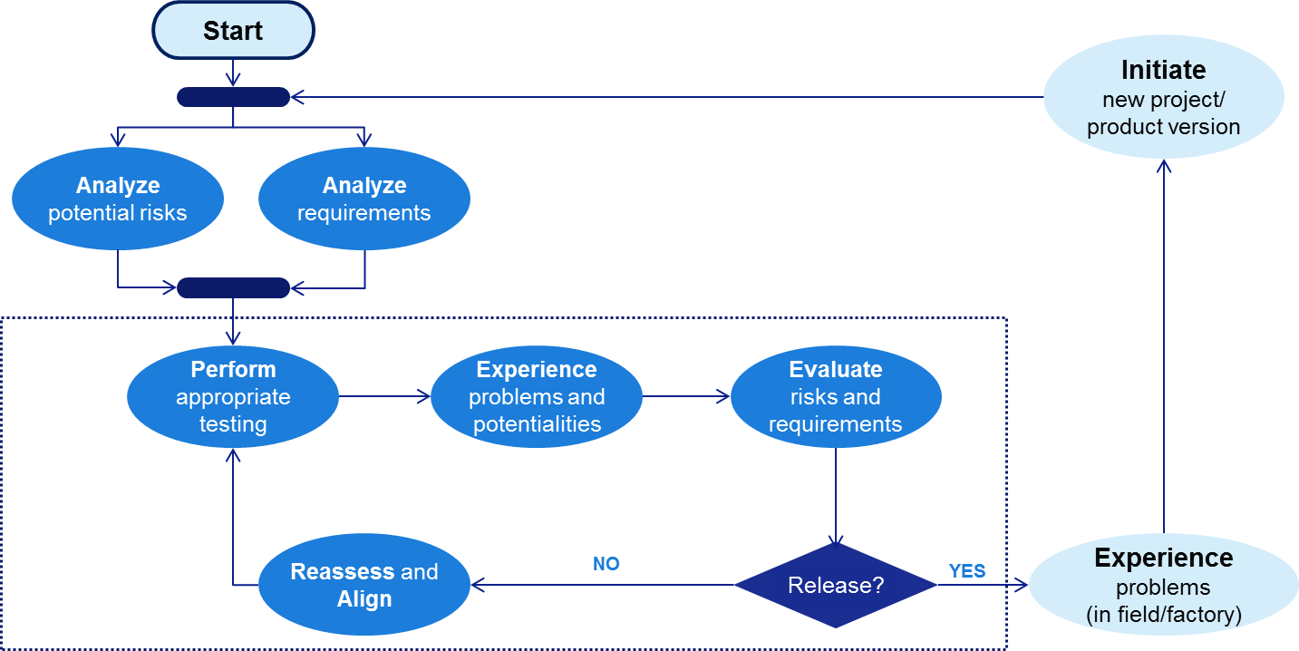
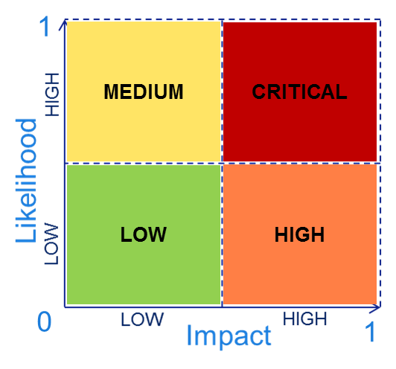

ANALYZE POTENTIAL RISKS, ANALYZE REQUIREMENTS
Determine/identify product risks
    Identify risks, assess risks
Determine (product) requirements
    Include product features and quality criteria
Match risks and requirements
    Assess risks brought by requirements
WHO?
HOW? WHAT MEANS?
step DELIVERY
Notes:
Matching: functional priority, linking requirements to product risks, risk priority
“No risk, no test!”
FMEA: Failure mode and effects analysis, https://en.wikipedia.org/wiki/Failure_mode_and_effects_analysis
HTSM: Heuristic Test Strategy Model, www.satisfice.com/tools/htsm.pdf
ISO:25010, https://www.iso.org/standard/35733.html

Slide 12
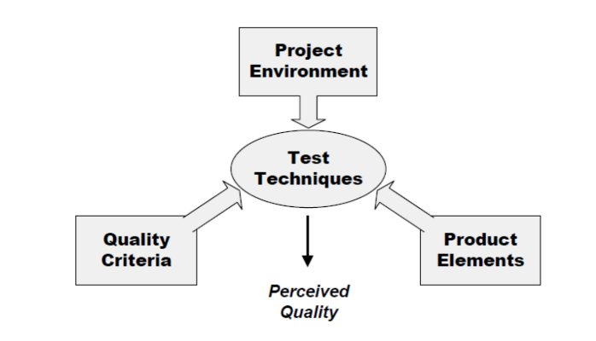
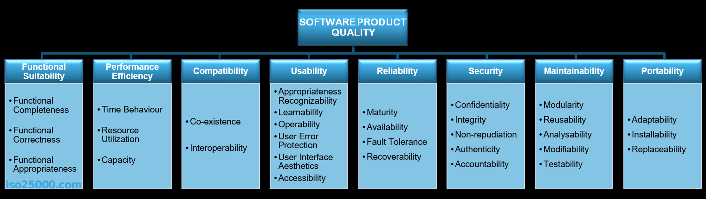
Quality characteristics ISO:25010
Notes:
ISO:25010, https://www.iso.org/standard/35733.html
ISO/IEC 25010:2011 defines:
A quality in use model composed of five characteristics (some of which are further subdivided into subcharacteristics) that relate to the outcome of interaction when a product is used in a particular context of use. This system model is applicable to the complete human-computer system, including both computer systems in use and software products in use.
A product quality model composed of eight characteristics (which are further subdivided into subcharacteristics) that relate to static properties of software and dynamic properties of the computer system. The model is applicable to both computer systems and software products.

Slide 13
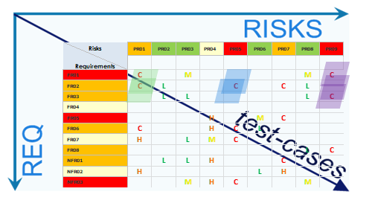
PERFORM APPROPRIATE TESTING
Plan test activities, design test-cases
    High risk areas might be covered first
Target what to test, where, and how
    Requirement verification methods or tests
    Risk mitigation methods or tests
    Complex requirements/features
    Performance
WHO?
HOW? WHAT MEANS?
step DELIVERY
Notes:
Matching: functional priority, linking requirements to product risks, risk priority
“No risk, no test!”
FMEA: Failure mode and effects analysis, https://en.wikipedia.org/wiki/Failure_mode_and_effects_analysis
HTSM: Heuristic Test Strategy Model, www.satisfice.com/tools/htsm.pdf
ISO:25010, https://www.iso.org/standard/35733.html

Slide 14
EXPERIENCE PROBLEMS AND POTENTIALITIES
Execute tests
    Deploy tests at the appropriate level
    Analyze test results, include diagnostics, tracing, logs
    Update status of the matrix based on the plan and results, QAF
TESTING FOCUS
WHO?
HOW? WHAT MEANS?
step DELIVERY
Notes:
Matching: functional priority, linking requirements to product risks, risk priority
“No risk, no test!”
FMEA: Failure mode and effects analysis, https://en.wikipedia.org/wiki/Failure_mode_and_effects_analysis
HTSM: Heuristic Test Strategy Model, www.satisfice.com/tools/htsm.pdf
ISO:25010, https://www.iso.org/standard/35733.html

Slide 15

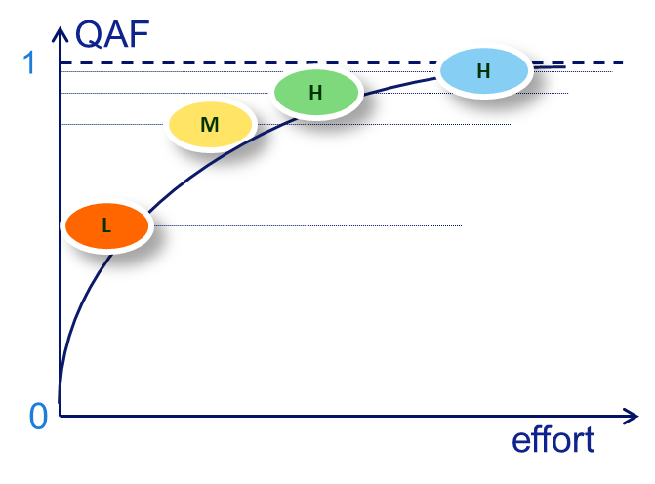
EVALUATE RISKS AND REQUIREMENTS
Analyze actual risks and their mitigation status
  Check whether new risks have emerged/have been uncovered
Analyze requirements and their verification status
Prepare input for (potential) release decision
    Report on residual risks and potential benefits
    Provide insight into the quality of the current product
Quality Assessment Factor
WHO?
HOW? WHAT MEANS?
step DELIVERY
Notes:
Matching: functional priority, linking requirements to product risks, risk priority
“No risk, no test!”
FMEA: Failure mode and effects analysis, https://en.wikipedia.org/wiki/Failure_mode_and_effects_analysis
HTSM: Heuristic Test Strategy Model, www.satisfice.com/tools/htsm.pdf
ISO:25010, https://www.iso.org/standard/35733.html

Slide 16
Determine QAF and Rationale
RISKS
Risk ID | QAF | Rationale | Test Cases/ Mitigation Method
REQ
REQ ID | QAF | Rationale | Test Cases/ Verification Method
Level | Description
1 | Requirements defined, no verification activities initiated Risks analyzed, no mitigation activities initiated
2 | Requirements verification activities initiated Risks mitigation activities initiated
3 | Requirements tested, verification of important requirements achieved Risks mitigation activities on risks in focus
4 | Requirements thoroughly tested, gaps identified and accepted Risks mitigated, likelihood reduced and contingency plan in place
5 | Requirements verified, maximum requirements coverage achieved Risks mitigated, likelihood reduced to a minimum and impact contained
Very Low
Low
Moderate
High
Highest

Slide 17
RЯBT - Summary
RЯBT is a Structured Testing approach:
Combines requirements and risk-based testing
  Uses their advantages and minimizes their disadvantages
Lean, light-weight process, fits in both agile and traditional dev. processes
Risk Statements, use team power / knowledge to discover risks
Requirements centric in risk identification, mitigation and reporting
Traceability, risks/requirements ➔ test-cases ➔ results
Reporting on Quality Assessment Factor, use team power / engagement of client

Slide 18
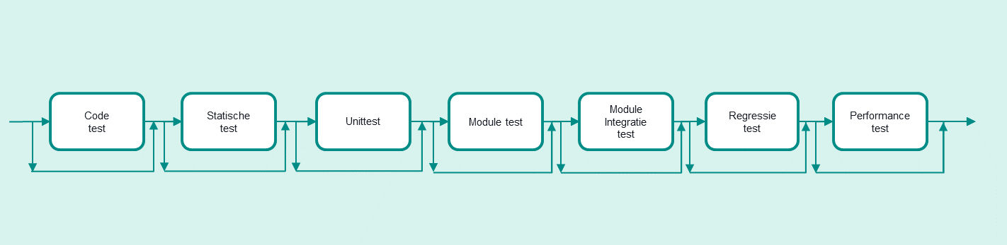


Development & Test process
Requirements
and quality characteristics
Leverancier
STR
STD
Requirements coverage
Open findings
new risks
Prepare test cases
execute test cases
Record and re-test findings
ISO 25010
Agile
Test Approach driven by:
  Product risks & selected quality characteristics
  The requirements list is drawn up by the client (or by team with client’s approval)
  100% tracing of requirements
  100% test coverage against requirements and product risks
  A selection of test types / test forms from test process that are required to cover the requirements & risks with tests.

Slide 19
Test approach
Test process driven by risks
Requirements
And quality characteristics
Leverancier
STR
STD
Requirements coverage
Open findings
new risks
Prepare test cases
execute test cases
Record and re-test findings
Risks
Bugs and risks
Handling product risks
1. Risk identification
2. Risk analysis
3. Risk mitigation
4. Risk monitoring
Residual risks
Adjustment

Slide 20

Quality characteristics ISO:25010
Notes:
ISO:25010, https://www.iso.org/standard/35733.html
ISO/IEC 25010:2011 defines:
A quality in use model composed of five characteristics (some of which are further subdivided into subcharacteristics) that relate to the outcome of interaction when a product is used in a particular context of use. This system model is applicable to the complete human-computer system, including both computer systems in use and software products in use.
A product quality model composed of eight characteristics (which are further subdivided into subcharacteristics) that relate to static properties of software and dynamic properties of the computer system. The model is applicable to both computer systems and software products.

Slide 21
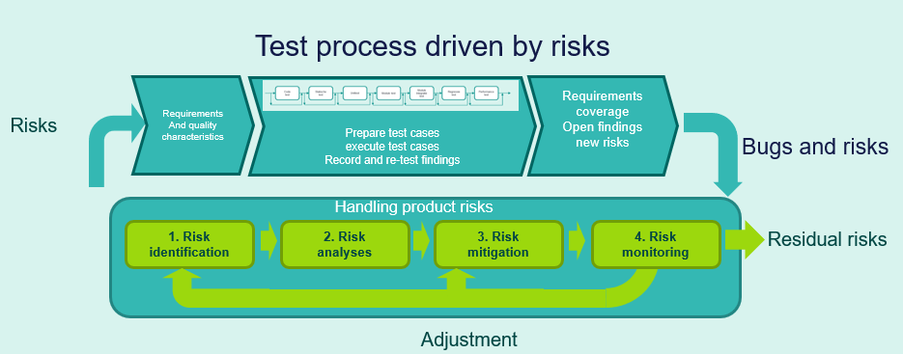


1. Risk identification
The test basis: Product risks for subsystem in scope
Risk Id | Quality (ISO 25010) and Description of risk | Chance of failure X Impact after failure = Score | Comments
R1 | Functional-Correctness Subsystem X provides incorrect or incomplete status information about the Management Status API interface.
R2 | Reliability-Availability If Subsystem X sends a request for Subsystem X to the Subsystem X with a high frequency request, then the availability of Subsystem X is greatly reduced, which puts the train service at risk.
R3 | Performance-Efficiency Subsystem X cannot process a request from a client for the interface Y Management Status API within 0.5 seconds.
For every subsystem we select at least 3 product quality attributes from e.g. the ISO 25010
Project Team & Client

Slide 22
2. Risk analysis
Weighted risks, starting point for testing
Risk Id | Description of risk | Chance | Impact | Risk class
R1 | Functional-Correctness Subsystem X provides incorrect or incomplete status information about the Management Status API interface. | Low | Medium | B
R2 | Reliability-Availability If Subsystem X sends a request for Subsystem X to the Subsystem X with a high frequency request, then the availability of Subsystem X is greatly reduced, which puts the train service at risk. | Low | Medium | C
R3 | Performance-Efficiency Subsystem X cannot process a request from a client for the interface Y Management Status API within 0.5 seconds. | Medium | High | B
Project Team & Client

Slide 23


3. Risk mitigation
Select test type
Eisen en maatregelen | Testsoort | Wie
Covering requirements ANS-01 to ANS-4 | Statische test: code review | Developer
ANS-01 to ANS-016, Prepare test design with test techniques to prepare test cases. Data combination test (formal test technique) and Exploratory test (looking for the corners) Also provides insight into risk R1 (risk class B) | Module test (functional tests) | Tester
Require ANS-10 to ANS-16 regression test | Regression test | Tester
ANS-05 to ANS-12 and insight into risks R2 and R3 have to do with performance efficiency: Speed: measuring performance interface: Performance test. Reliability: Availability: Load test to measure availability part system with load on the interface. | Performance test | Tester
Risk Measure
Tester

Slide 24
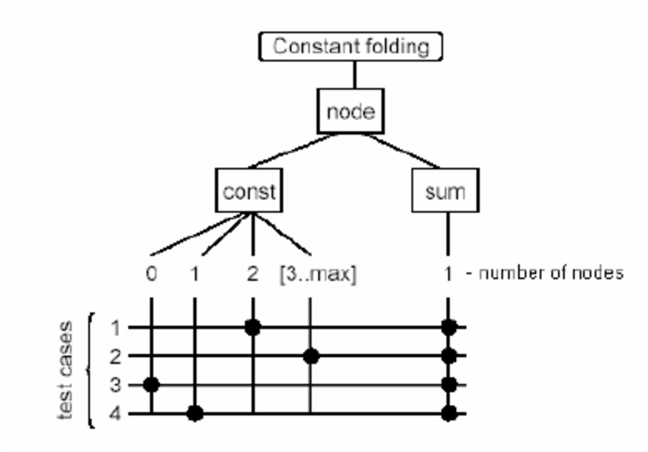
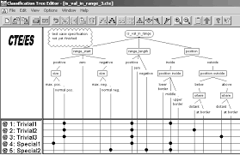
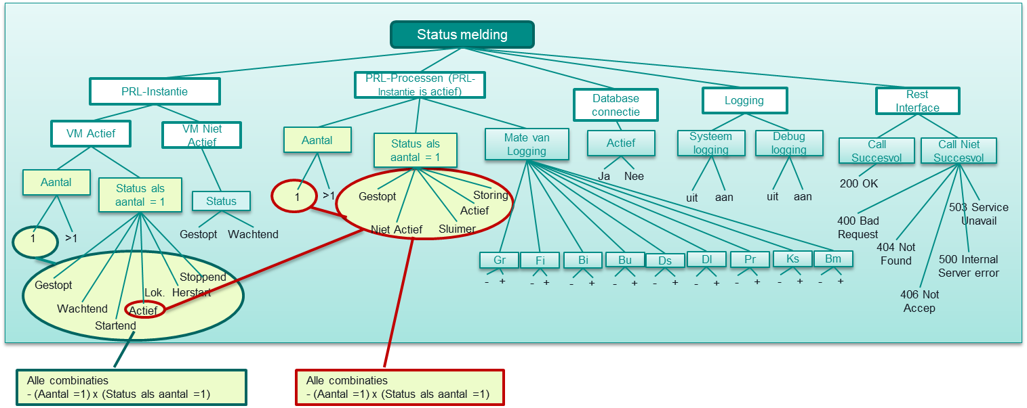
3. Risk mitigation
Determine test severity
Module test (1) Data combination test
Quality characteristic: Functional correctness,
Risk class B, test approach: Functional testing,
Risk class B, test weight “Normal”
Data combination test with 2 data pairs selected based on the different test items in the requirement list.
Make a sketch
Risk Measure
Tester

Slide 25


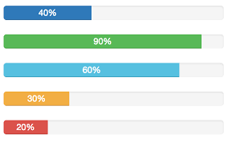
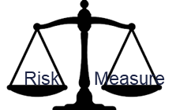
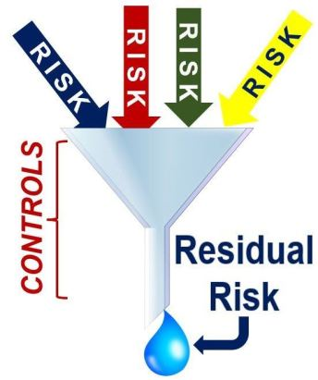

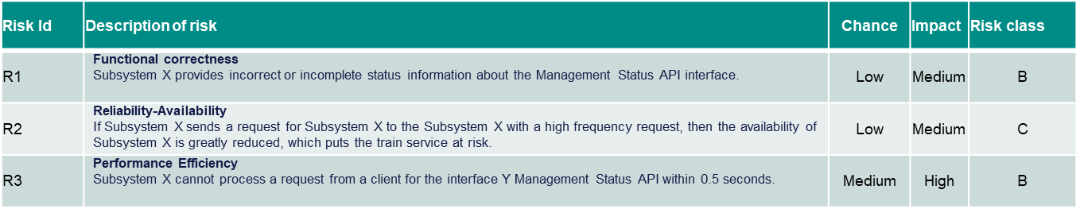
3. Risk mitigation: Testing
Test cases for 100% coverage requirements
Test progress
Requirements coverage
Test execution
Open findings and risks related
Bug | Description | Severity | Status | Risk
PTL-1344 | correct working of SSS functions dependent of link order | Normaal | Open | R1
PTL-1411 | SYSTEEM_Call D discs are not correctly displayed. | Cosmetisch | Open | R2
PTL-1416 | opening a file with HIST::UNKNOWN: fails if the related dot file is not present. | Normaal | Open | R2
PTL-1478 | Call T does not work after call to library | Ernstig | Open | R3
PTL-1480 | Call X does not work with only two parameters | Ernstig | Open | R3
PTL-1553 | Call Y gives different result as on OpenVMS | Normaal | Open | R3
PTL-1566 | Call T unit test fails due to errors in call B and call Z | Normaal | Open | R3
Tester
Weighted risks

Slide 26
4. Risk monitoring
Score risks after testing
Risk Id | Description of risk | Test progress % tested | Number of findings Open "Blocking" | Number of findings Open “Major" | Number of findings Open "Normal / Cosmetic" | Residual risks determined after test
R1 | Functional-Correctness Subsystem X provides incorrect or incomplete status information about the Management Status API interface. | 80 |  |  | 1 | Residual risk is limited
R2 | Reliability-Availability If Subsystem X sends a request for Subsystem X to the Subsystem X with a high frequency request, then the availability of Subsystem X is greatly reduced, which puts the train service at risk. | 90 |  |  | 2 | Residual risk is limited
R3 | Performance-Efficiency Subsystem X cannot process a request from a client for the interface Y Management Status API within 0.5 seconds. | 50 |  | 2 | 2 | Residual risk is considerable
Legend classification residual risks
Residual risk is high: Several serious or blocking findings are open
Residual risk is considerable: A serious finding is open
Residual risk is limited: A few findings are still open in the Normal and or cosmetic category
There is no residual risk: No more findings are open
Project Team

Slide 27
Progress reporting
At end but also during project
 | Results |  |  | Comments
Requirements coverage | 16 requirements have been specified. 5 test cases have been specified to cover all requirements (100%).
Test results | 3 test cases executed: 2 OK, 1 NOK, 2 Not Run.
Bugs | 7 open findings, 2 serious, 4 normal and 1 cosmetic.
Top 3 risks | Description of risk | % tested | Residual risks after testing | What to do: Execute the 2 tests not yet performed, Re-testing of open findings Execute performance and regression testing
 | Functional-Correctness Subsystem X provides incorrect or incomplete status information about the Management Status API interface. | 75 | Residual risk is limited
 | Reliability-Availability If Subsystem X sends a request for Subsystem X to the Subsystem X with a high frequency request, then the availability of Subsystem X is greatly reduced, which puts the train service at risk. | 75 | Residual risk is limited
 | Performance-Efficiency Subsystem X cannot process a request from a client for the interface Y Management Status API within 0.5 seconds. | 30 | Residual risk is considerable
Project Team & Client

Slide 28
QRBT - Summary
QRBT is a Structured Testing approach:
Better and effective test reporting by making use of residual risks
It is the basic for adjusting the test process
Informing the client in the residual risks creates support and involvement (gain support)
Which results in trusted and improved communication with the client
Lean, light-weight process, fits in both agile and traditional dev. processes
Risk Statements, use team power / knowledge to discover risks
Quality Attributes centric in risk identification, mitigation and reporting
Traceability, risks/requirements ➔ test-cases ➔ results
Reporting on Residual Risks, engagement of client in whole process

Slide 29
Differences and Similarities between the two approaches
Light weight process
Driven by Risk management process
Requirement Centric
Traceability,
Report on Quality Assessment Factor (expert)
Light weight process
Driven by Risk management process
Quality Attributes Centric
Traceability,
Report on Residual Risks (Client)

Slide 30
Main benefits of the two approaches
  Better and effective test reporting by making use of residual risks and confidence factor.
  Involvement of the complete team, including stakeholders
  Informing the client about the residual risks to gain support and involvement
  Achieving trusted and improved communication with the client

Slide 31
Summary and Lessons learned
Apply an agile process to deliver value at minimized risks
Involve stakeholders
Results of the whole team count → team power
Strive for team confidence in the deliveries, quality must be built-in

Slide 32

Thank you!

Slide 33
Acknowledgment
For RЯBT, we would like to thank Andrzej Lisowski and Ruud Cox for their contributions and the discussions in the past period.
For QRBT, we would like to thank Jaap Kuilman for his contributions and the discussions around this topic.
For more information contact:
Goce.naumoski@asml.com
Rachid.Kherrazi@akka.eu

Slide 34
References
A non-exhaustive list of methods/approaches
HTSM (Heuristic Test Strategy Model) – J. Bach
RBT (Risk-Based Testing) – H. Schaefer, C. Kaner, J. Bach, P. Gerard
HRBT (Heuristic Risk-Based Testing) – J. Bach
RST (Rapid Software Testing) – M. Bolton
Requirements-Based Testing – (Bender RBT Inc; J. Bach)
RRBT (Requirements Risk-Based Testing) – B. Bronneberg, (RЯBT – G. Naumoski)
QRBT (Quality attributes Risk-Based Testing) – R. Kherazi
iRBA (innovative Risk Based Analysis) – E. Menasheof
(PRA) Product Risk Analysis, TMap
SCRUM
MDE, Model Driven Engineering
ASD (Analytical Software Design)
MBT, Model Based Testing

