Slide 1

Model-Based Testing
Explained and Demonstrated
The Craft of Model-Based Testing
QA&Test 2021
Paul C. Jorgensen

Slide 2
Presentation Outline
Introduction
About models
Model-Based Testing
Today’s examples
Commercial MBT products
Open source MBT tools
The Craft of Model-Based Testing

Slide 3
About Paul Jorgensen
20-year career developing and testing telephone switching systems
31 years teaching graduate level software engineering
Author of
  Modeling Software Behavior-A Craftsman’s Approach
  The Craft of Model-Based Testing (today’s topic)
  Software Testing-A Craftsman’s Approach (Fifth edition)
Introduced Model-Based Testing on a telephone switching systems project in Italy 1978 – 1981
Professor Emeritus of Computer Science since 2017 (7-day weekend every week!)
The Craft of Model-Based Testing

Slide 4

This Presentation
Taken directly from The Craft of Model-Based Testing
The Craft of Model-Based Testing

Slide 5
2. About Models
2 Views of good model:
  As a compromise with reality, and
  As a caricature of
As a compromise…
  Most models are somewhat incomplete
  It is a mistake to try to model EVERYTHING
As a caricature…
  Describe the important features of the application
Effective modeling involves
  Talent
  Understanding
  judgment
The Craft of Model-Based Testing

Slide 6
Advantages of Models
Improve understanding of the application
Basis for developing test cases
Accurate description of the application
Formal models can be “provocative”, that is the discipline of developing the model reveals items that otherwise may not be recognized. This is particularly true of decision tables.
Some models are executable, the engines can automatically generate test scenarios. Examples:
  Finite state machines
  Extended Petri nets
  Statecharts
The Craft of Model-Based Testing

Slide 7
Types of Models
Structural
  Supports the is view of an application
  Best example: UML class models
  Also: dataflow diagrams, Entity/Relation diagrams
Behavioral
  Supports the does view of an application
  UML Activity (Sequence) diagrams
  Flowcharts
  Decision tables
  Finite state machines
  Statecharts
  Extended Petri nets
  Business Process Modeling Notation (BPMN)
The Craft of Model-Based Testing

Slide 8
3. Model-Based Testing
3 common forms (see Utting 2010)
  Manual
  Semi-automated
  Fully automated
We briefly look at each of these next
The Craft of Model-Based Testing

Slide 9
Manual Model-Based Testing Steps
Develop a model of the application; most likely a finite state machine (fsm)
Identify paths in the fsm visually
Apply some selection criteria to the identified paths; e.g., some coverage metric
“Concretize” the selected (abstract) test cases: e.g., replace “UserID” with “Paul Jorgensen” to create actual test cases.
The Craft of Model-Based Testing

Slide 10
Semi-Automated Model-Based Testing
Distinguished by the early use of tools
Uses an executable model, e.g., finite state machines
Use of an engine that
  Executes the model, and
  Derives abstract test cases
Remaining steps as in manual Model-Based Testing
  Apply some selection criteria to the identified paths; e.g., some coverage metric
  “Concretize” the selected (abstract) test cases
The Craft of Model-Based Testing

Slide 11
Fully Automated Model-Based Testing
Repeats steps of semi-automated MBT
Uses an executable model, e.g., finite state machines
Use of an engine that
  Executes the model, and
  Derives abstract test cases
  Apply some selection criteria to the identified paths; e.g., some coverage metric
  “Concretize” the selected (abstract) test cases
Finish with automated test case execution
(We will see most of this process on our two examples.)
The Craft of Model-Based Testing

Slide 12
4. Today’s Examples
David Harel [Harel 1988] identifies two fundamentally different kinds of programs—transformational and reactive.
  Transformational programs are data driven, and transform their inputs into their outputs. They are usually “one shot” programs.
  Reactive programs are “long running” and they “maintain a relationship with their environment.”
Our transformational example is an Insurance Premium program.
Our reactive example is a Garage Door Controller
The Craft of Model-Based Testing

Slide 13
The Insurance Premium Program
Premiums on an automobile insurance policy are computed by
  The base rate ($600)
  The age of the policy holder (16 <= age < 25; 25 <= age < 65; 65 <= age <90)
  People under age 16 or over 90 cannot be insured.
  The number of “at fault” claims in the last five years (0, 1 to 3, 4 to 10)
  Drivers with more than 10 at fault claims in the past five years cannot be insured
  The reduction for being a good student ($50) (we skip this one)
  The reduction for being a non-drinker. ($75)
The Craft of Model-Based Testing

Slide 14
Details of the Input Variables
Age range coefficients
  16 <= age < 25: x = 1.5
  25 <= age < 65: x = 1.0
  65 <= age <90: x = 1.2
“At fault” claims
  0: $0.00
  1 to 3: $100.00
  4 to 10: $300.00
Non-drinker reduction: $75.00
The Craft of Model-Based Testing

Slide 15
The Garage Door Controller
The Garage Door Controller has these components
  a drive motor
  the garage door wheel tracks with sensors at the open and closed positions
  a control device
The Craft of Model-Based Testing
The Garage Door Controller has these components
  a drive motor
  the garage door wheel tracks with sensors at the open and closed positions
  a control device

Slide 16
The Garage Door Controller (continued)
When the Garage Door reaches one of the end of track sensors, the door stops.
Here is a SysML diagram of the Garage Door Controller
The Craft of Model-Based Testing

Slide 17
4.1 Modelling the Insurance Premium Program
A decision table is my first choice for this program. It is complete and defines 18 test cases. Here is the first third of the table:
The Craft of Model-Based Testing
Rules | 1 | 2 | 3 | 4 | 5 | 6
c1. Age Range | 16 <= age < 25
c2. At fault claims | 0 |  | 1 - 3 |  | 4 - 10
c3. Non-drinker? | T | F | T | F | T | F
a1. x = 1.5 | x | x | x | x | x | x
a2. x = 1.0
a3. x = 1.2
a4. penalty is $0.00 | x | x
a5. penalty is $100.00 |  |  | x | x
a6. penalty is $300.00 |  |  |  |  | x | x
a7. reduction is $75.00 | x |  | x |  | x

Slide 18
Derived test cases
Each rule is a test case. Since the decision table is complete, we know we have a complete set of test cases.
Inputs for the test case corresponding to Rule 1 are
  Age range = 16 <= age < 25
  At fault claims = 0
  Non-drinker = True
The derived test case would use the formula
  Premium = (600 x 1.5) – 75
  Premium = $825.00
The Craft of Model-Based Testing

Slide 19
4.2 Modelling the Garage Door Controller
A finite state machine is my first choice for this program. It is the model used by the commercial MBT tool providers.
To start, we identify the input events, output events, and states of our model.
Input Events:
  e1: control signal
  e2: end of down track sensed
  e3: end of up track sensed
  e4: laser beam crossed
The Craft of Model-Based Testing

Slide 20
Garage Door Controller FSM (continued)
Output Events:
  a1: start drive motor down
  a2: start drive motor up
  a3: stop drive motor
  a4: reverse drive motor down to up
States:
  s1: door up
  s2: door up
  s3: door stopped going down
  s4: door stopped going up
  s5: door closing
  s6: door opening
The Craft of Model-Based Testing

Slide 21
Garage Door Controller FSM
The Craft of Model-Based Testing

Slide 22
Test Cases from the Garage Door Controller FSM
The loops in the Garage Door FSM imply an infinite number of possible paths.
As testers, we need to make intelligent, theory-based choices.
Consider these paths, described as state sequences
  p1: Normal door close (s1, s5, s2)
  p2: Normal door close with one intermediate stop (s1, s5, s3, s5, s2)
  p3: Normal door open (s2, s6, s1)
  p4: Normal door open with one intermediate stop (s2, s6, s4, s6, s2)
  p5: Normal door close with light beam interruption (s1, s5, s6, s1)
We could add a “Soap Opera” test case:
  (s1, s5, s3, s5, s6, s4, s6, s1)
The Craft of Model-Based Testing

Slide 23
About our Test Cases
The first five paths..
  Every state
  Use every input event
  Use every output action
The “Soap Opera” test case:
  Only misses state s2
  Uses every input event
  Uses every output event
  Is a good candidate for a regression test
The Craft of Model-Based Testing

Slide 24
5. MBT Commercial Products
Smartesting Yest and CertifyIt
TestOptimal
Conformiq
Elvior
sepp.med GmbH
Verified Systems International GmbH
Each vendor applied its product to our Insurance Program and Garage Door examples.
Their results will be summarized in the following slides.
The Craft of Model-Based Testing

Slide 25
5.1 Smartesting Yest and CertifyIt
Located in Besançon, France
Bruno Legeard is one of the principals
Uses JUnit
Yest is for business applications
  business process modeling,
  decision tables,
  and decision trees
CertifyIt is for complex, or event-driven systems
  requires some technical skills
  need to have dedicated users
  advisable to have Smartesting team involved in the tool introduction
The Craft of Model-Based Testing

Slide 26
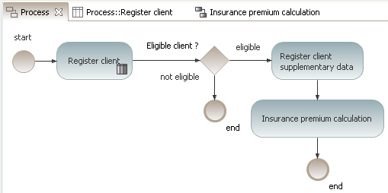
Insurance Premium Models
The Craft of Model-Based Testing

Slide 27
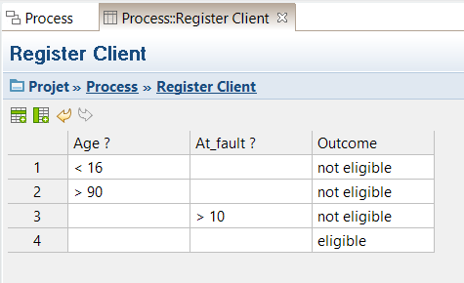
Insurance Premium Models
The Craft of Model-Based Testing

Slide 28
Insurance Premium Test Cases
7 test cases (test case 4 here)
4 | [16-25] | 0 | yes |  | yes | Premium = 775
 | Actions |  |  | Expected results
 | Enter client age: 19
 | Enter client at fault claims: 0
 | Validate entry |  |  | The client is eligible
 | Enter client as a good student
 | Enter client as a non-drinker
 | Insurance Premium Calculation |  |  | The Insurance Premium Calculation is 775, and the offer is registered in the database
The Craft of Model-Based Testing

Slide 29
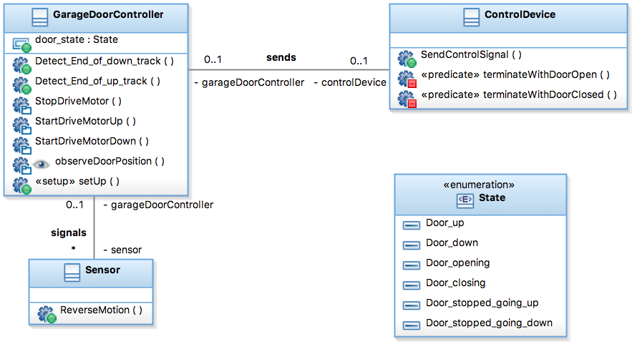
Garage Door Models
The Craft of Model-Based Testing

Slide 30
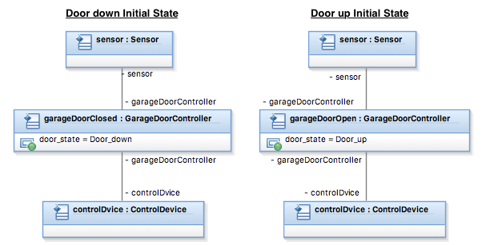
Garage Door Models
The Craft of Model-Based Testing

Slide 31
Garage Door Test Cases
14 test cases (test case 3 here)
3 | Step 1 | s2: Door Down | e1: control signal | a1: start drive motor up | s6: Door opening
 | Step 2 | s6: Door opening | e3: end of up track hit | a3: stop drive motor | s1: Door Up
 | Step 3 | s1: Door Up | e1: control signal | a1: start drive motor down | s5: Door closing
 | Step 4 | s5: Door closing | e1: control signal | a3: stop drive motor | s3: Door stopped going gown
 | Step 5 | s3: Door stopped going gown | e1: control signal | a1: start drive motor down | s5: Door closing
The Craft of Model-Based Testing

Slide 32
5.2 TestOptimal
TestOptimal is located near Rochester, Minnesota, USA
See the company website [http://testoptimal.com/] for the extensive list of features, including
  Extended Finite State Machine (EFSM)
  State Diagram (UML)
  Control Flow Graph (CFG)
  Activity Diagram (UML)
Integrates with
  ALM,
  java IDE (Eclipse, NetBeans),
  JUnit, batch
Test case generation
  pairwise,
  combinatorial algorithms,
  pattern based data generation
The Craft of Model-Based Testing

Slide 33
Insurance Premium Test Cases
Abstract test cases
Test Case | Age | Claims | Good Student | Non-drinker | Expected Premium
1 | 16 - 24 | 0 | false | false | 775
2 | 16 - 24 | 1 - 3 | true | false | 1000
3 | 16 - 24 | 4 - 10 | false | true | 1150
4 | 25 - 64 | 0 | true | false | 525
5 | 25 - 64 | 1 - 3 | false | true | 575
6 | 25 - 64 | 4 - 10 | true | false | 900
7 | 65 - 89 | 0 | false | true | 770
8 | 65 - 89 | 1 - 3 | true | false | 1125
9 | 65 - 89 | 4 - 10 | false | false | 970
The Craft of Model-Based Testing

Slide 34
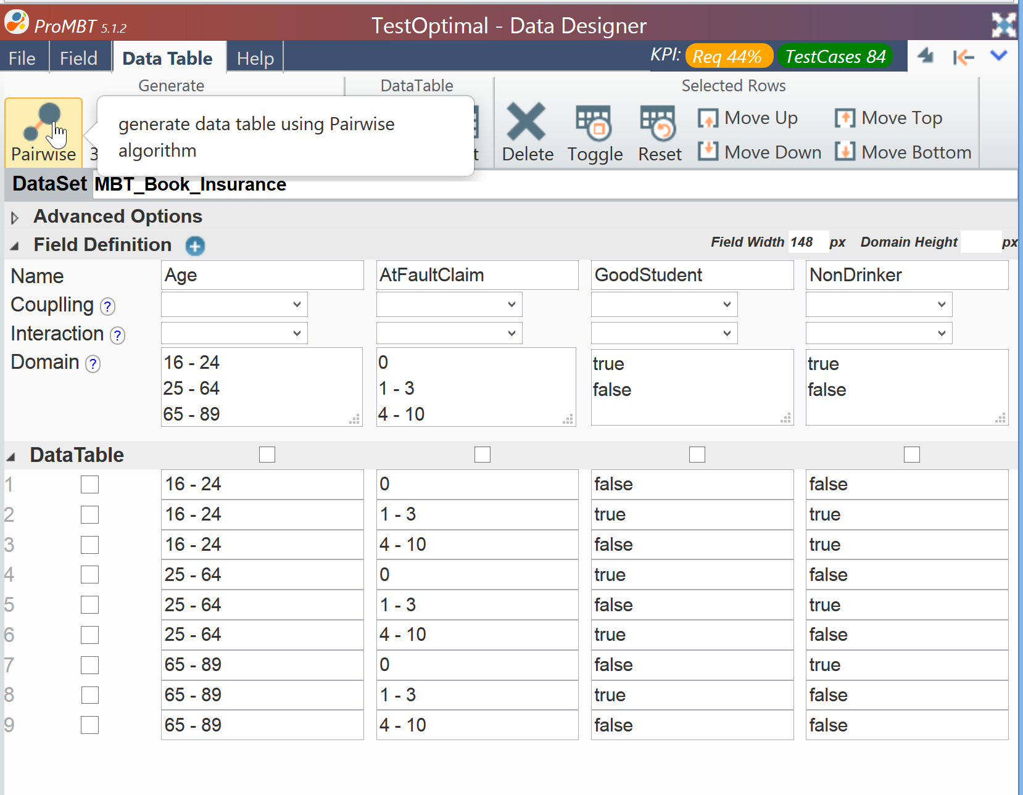
Concrete data values
The Craft of Model-Based Testing

Slide 35
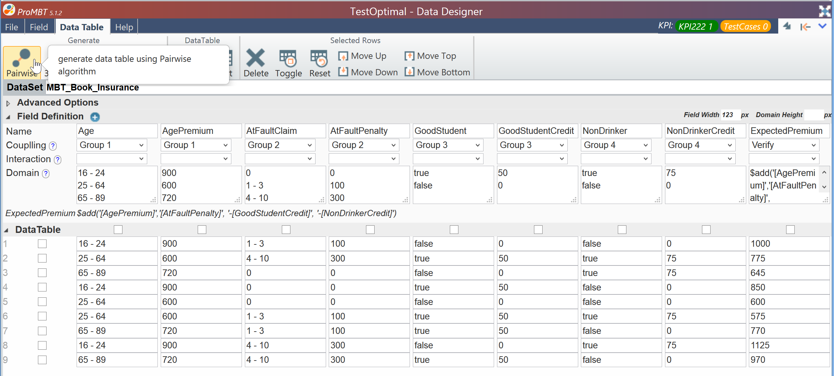
Concrete Pairwise Values
The Craft of Model-Based Testing

Slide 36
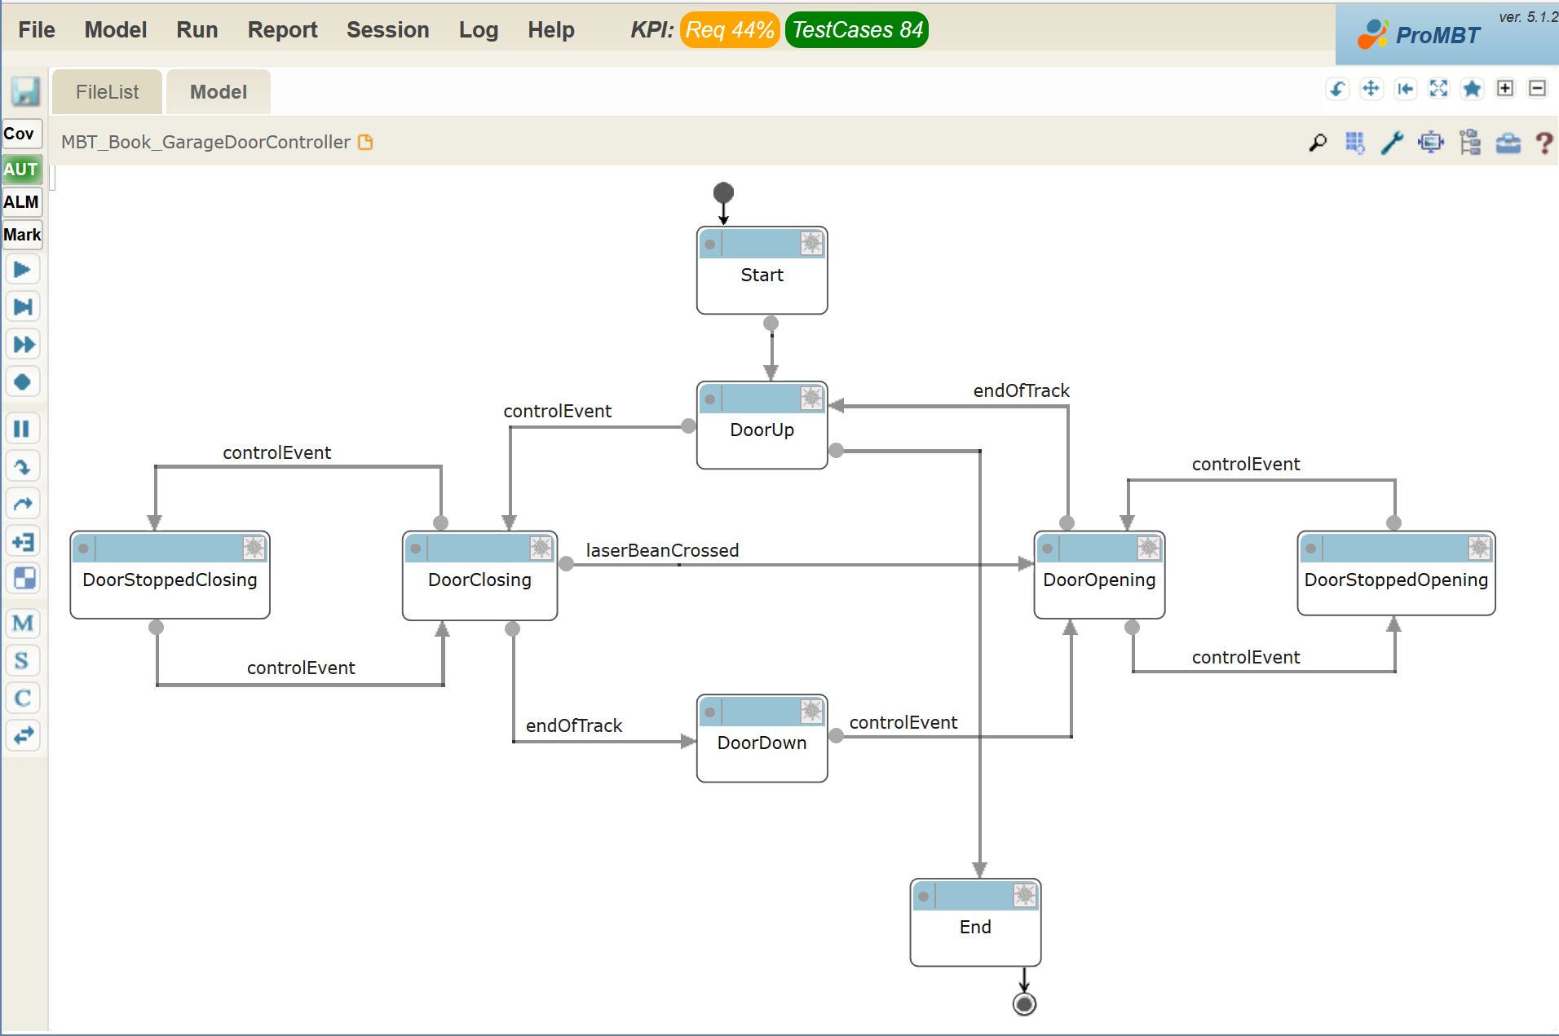
Garage Door FSM
The Craft of Model-Based Testing

Slide 37
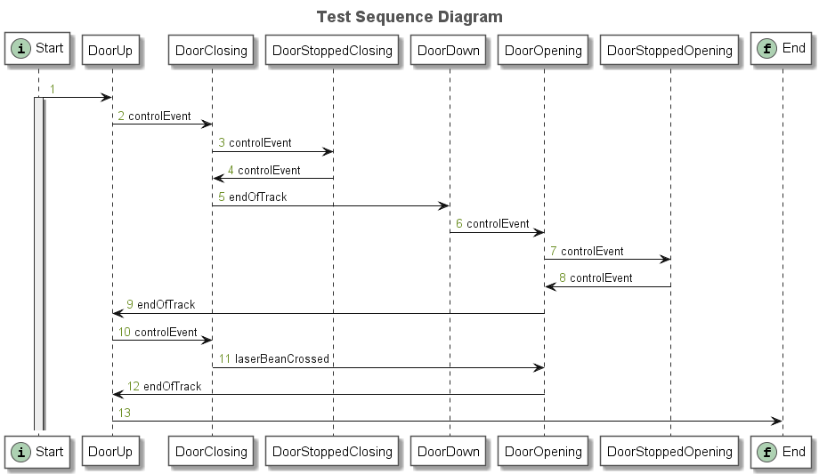
Garage Door UML Sequence Diagram
The Craft of Model-Based Testing

Slide 38
Sample Test Case (6 of 11 steps)
Step | Action | Expected Results
(weight: 55, length: 11)
1 | From: DoorUp Do: controlEvent Input: controlEvent | At: DoorClosing Expect Garage Door State: DoorClosing
2 | From: DoorClosing Do: controlEvent Input: controlEvent | At: DoorStoppedClosing Expect Garage Door State: DoorStoppedClosing
3 | From: DoorStoppedClosing Do: controlEvent Input: controlEvent | At: DoorClosing Expect Garage Door State: DoorClosing
4 | From: DoorClosing Do: endOfTrack Input: endOfTrack | At: DoorDown Expect Garage Door State: DoorDown
5 | From: DoorDown Do: controlEvent Input: controlEvent | At: DoorOpening Expect Garage Door State: DoorOpening
6 | From: DoorOpening Do: controlEvent Input: controlEvent | At: DoorStoppedOpening Expect Garage Door State: DoorStoppedOpening
 | From: DoorStoppedOpening Do: controlEvent | At: DoorOpening Expect Garage Door State: DoorOpening
The Craft of Model-Based Testing

Slide 39
5.3 Conformiq
Main product is Conformiq 360º Test Automation
  very comprehensive (far beyond test case generation)
  integrates with existing software development lifecycle starting from requirements management and Application Lifecycle Management (ALM) through test management and documentation, and automatic test execution tools.
Offices in
  headquarters in San Jose (California),
  main R&D center in Helsinki (Finland),
  branch offices in Stockholm, Bangalore, and Munich.
See company website https://www.conformiq.com
The Craft of Model-Based Testing

Slide 40
Conformiq Test Case Generation
Extremely comprehensive, featuring automatic
  generation of test inputs, including basic and structural data
  generation of expected test outputs, including basic and structural data
  support for requirements-driven test generation and requirement traceability
Support for
  boundary value analysis,
  multiple condition /multiple decision coverage,
  combinatorial data
  risk-based test generation
  executable test suites
  dependency ordering between generated test cases
  mathematical optimization of the generated test suites for efficiency and minimal test steps
The Craft of Model-Based Testing

Slide 41
Conformiq Modeling Options
Support for
  hierarchical UML2 state machine diagrams
  direct importing state machine diagrams
  Java-compatible textual notation as UML action language
  object-orientation, including classes, inheritance, multiple threads, and asynchronous communication between model threads
  arbitrary-precision arithmetic on model level
Integrates with
  UML models from IBM Rhapsody, Sparx Enterprise Architect, IBM RSD-RT
  import from flowcharts specified in MS Visio or BPMN tools like Software AG Aris, IBM RSA, Mega, etc
The Craft of Model-Based Testing

Slide 42
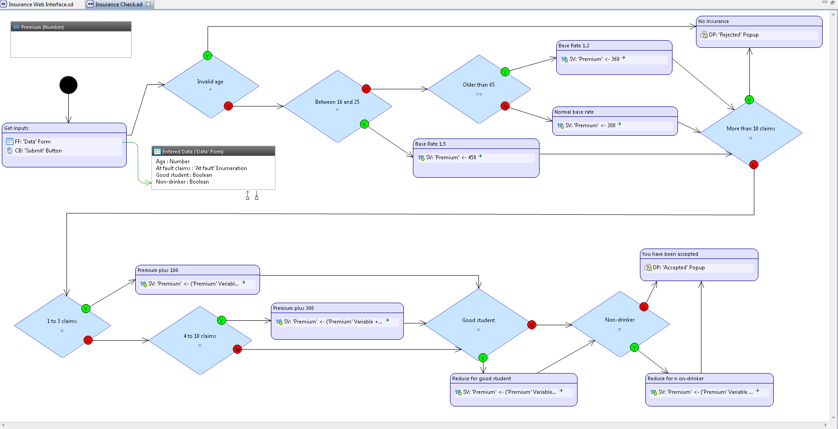
Insurance Premium Activity Diagram
The Craft of Model-Based Testing

Slide 43
Activity Diagram Details
The text in the decision boxes
  Invalid age?
  Between 16 and 25?
  Older than 65?
  More than 10 claims?, (then in the lower part...)
  1 to 3 claims?
  4 to 10 claims?
  Good Student?
  Non-drinker?
The actions shown as activities, i.e., the rounded rectangles,
  are used to model the interactions
  computations needed to compute the premium
The Craft of Model-Based Testing

Slide 44
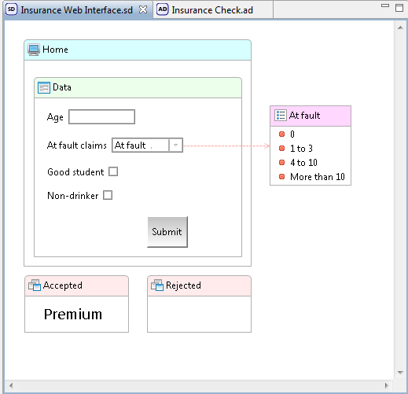
Web Interface
The Craft of Model-Based Testing

Slide 45
Insurance Premium Test Case1 (of 64)
Test case 1: | Decision/'Insurance Check' | Decision 'Invalid age'/Condition ((Age in 'Entered Data' Variable < 16) or (Age in 'Entered Data' Variable > 90)) is true
Step | Action(s) | Verification Point(s)
1 | Fill Data form in Home screen entering 0 in Age textbox | No errors can be observed at the SUT
2 | Click Submit button in the Home screen in the Data form | Application displays Rejected popup where Text is set to "Sorry, you are not eligible for insurance"
The Craft of Model-Based Testing

Slide 46
Insurance Premium Action Invocations
Action Invocations | A | B | C | D | E | F | G
'Insurance Check' /Activity 'Base Rate 1.2'/Action #1: SV: 'Premium' <- 360 |  |  |  | X | X | X | X
'Insurance Check' /Activity 'Base Rate 1.5'/Action #1: SV: 'Premium' <- 450 |  | X
'Insurance Check' /Activity 'Get inputs'/Action #1: FF: 'Data' Form | X | X | X | X | X | X | X
'Insurance Check' /Activity 'Get inputs'/Action #2: CB: 'Submit' Button | X | X | X | X | X | X | X
'Insurance Check' /Activity 'No insurance'/Action #1: DP: 'Rejected' Popup | X | X | X
'Insurance Check' /Activity 'Normal base rate'/Action #1: SV: 'Premium' <- 300 |  |  | X
'Insurance Check' /Activity 'Premium plus 100'/Action #1: SV: 'Premium' <- ('Premium' Variable + 100) |  |  |  | X | X
'Insurance Check' /Activity 'Premium plus 300'/Action #1: SV: 'Premium' <- ('Premium' Variable + 300) |  |  |  |  |  |  | X
'Insurance Check' /Activity 'Reduce for good student'/Action #1: SV: 'Premium' <- ('Premium' Variable - 50 |  |  |  |  | X | X | X
'Insurance Check' /Activity 'Reduce for n on-drinker'/Action #1: SV: 'Premium' <- ('Premium' Variable - 75) |  |  |  | X |  | X | X
'Insurance Check' /Activity 'You have been accepted to our insurance program and your premium will be $'/Action #1: DP: 'Accepted' Popup |  |  |  | X | X | X | X
The Craft of Model-Based Testing

Slide 47
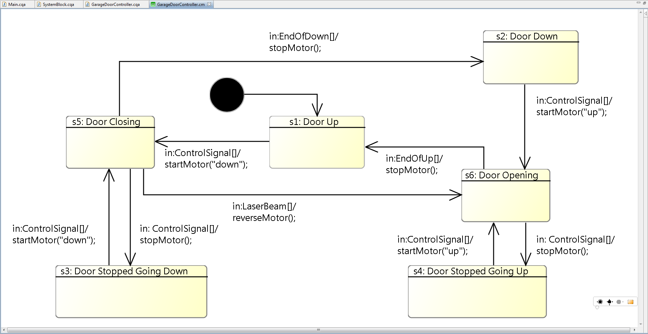
Garage Door UML State Machine
The Craft of Model-Based Testing

Slide 48
Garage Door Test Cases (1 and 2 of 17)
Test case 1: | s1, s5
Step | Action(s) | Verification Point(s)
1 | Provide system with input e1: control signal | System performs action a1: start drive motor "down".
Test case 2: | s1, s5, s3
Step | Action(s) | Verification Point(s)
1 | Provide system with input e1: control signal | System performs action a1: start drive motor "down".
2 | Provide system with input e1: control signal | System performs action a3: stop drive motor.
The Craft of Model-Based Testing

Slide 49
Garage Door Traceability
Test Case | State Sequence |  | Test Case | State Sequence
1 | s1, s5 |  | 10 | s1, s5, s3, s5, s6
2 | s1, s5, s3 |  | 11 | s1, s5, s2, s6, s1
3 | s1, s5, s2 |  | 12 | s1, s5, s6, s1, s5
4 | s1, s5, s3, s5 |  | 13 | s1, s5, s6, s4
5 | s1, s5, s6 |  | 14 | s1, s5, s2, s6, s4
6 | s1, s5, s2, s6 |  | 15 | s1, s5, s6, s4, s6
7 | s1, s5, s6, s1 |  | 16 | s1, s5, s6, s4, s6, s4
8 | s1,s5, s3, s5, s3 |  | 17 | s1, s5, s6, s4, s6, s1
9 | s1, s5, s3, s5, s2
The Craft of Model-Based Testing
Traceability of 4 other matrices is provided

Slide 50
Vendor Advice
Model-based testing is a disruptive approach to testing and needs to be managed as such. It requires us to change the way we work and enables a total testing transformation. One of the most challenging steps in adopting MB—as with any other disruptive technology—is to let go of well-established practices. One example is changing our thinking to go from tests to modeling system operation. Another example is changing test process metrics from measuring the number of tests towards to using actual test coverage. Another challenge with known test coverage is that we now not only know what we cover, but also what we don’t cover. This knowledge changes the way we work and think.

Slide 51
5.4 Elvior
Headquarters in Tallinn, Estonia, partnerships with
  VerifySoft in Germany
  Easy global Market in France
  Conformiq in Finland (and the US)
  Yashaswini Design Solutions and TCloud Information Technologies in India.
Product line includes
  Model-Based Testing services (based on TestCast MBT).
  TTCN-3 testing services;
  Model-Based Testing services (based on TestCast MBT
Website: http://Elvior.com
The Craft of Model-Based Testing

Slide 52
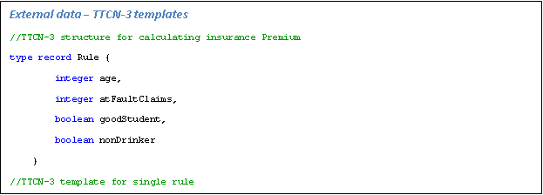
Insurance Premium Models
TTCN-3 Template
The Craft of Model-Based Testing

Slide 53
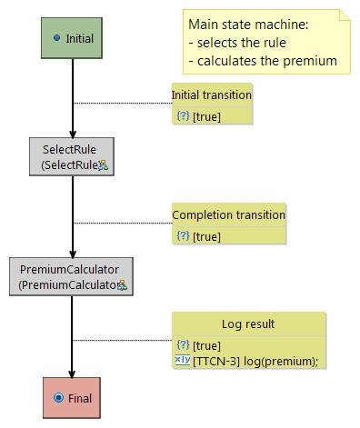
Insurance Premium Models
Behavioral Model
The Craft of Model-Based Testing

Slide 54
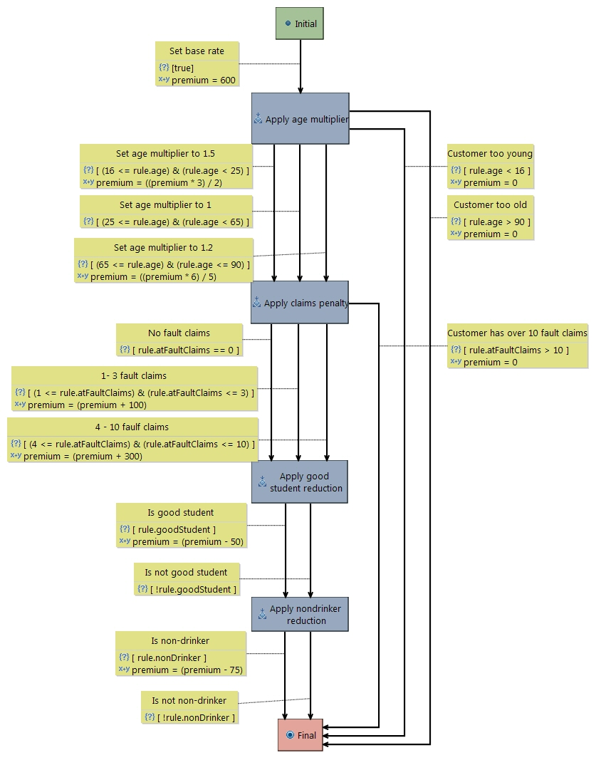
Insurance Premium Calculation
The Craft of Model-Based Testing

Slide 55
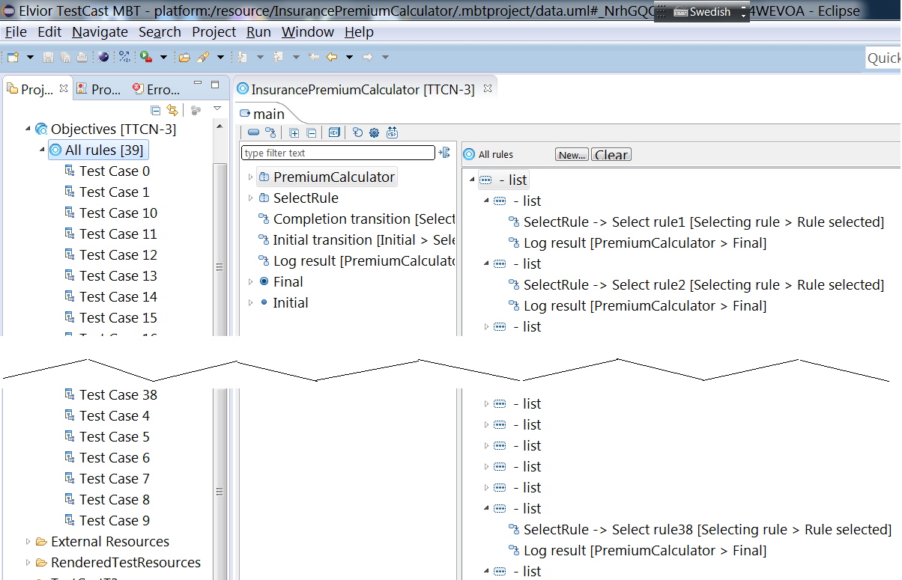
39 test cases (test objectives)
The Craft of Model-Based Testing

Slide 56
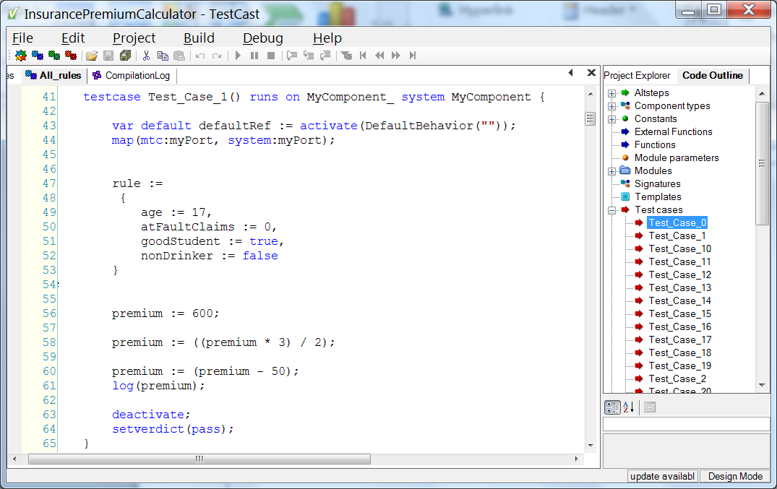
Executable TTCN-3 Script
The Craft of Model-Based Testing

Slide 57
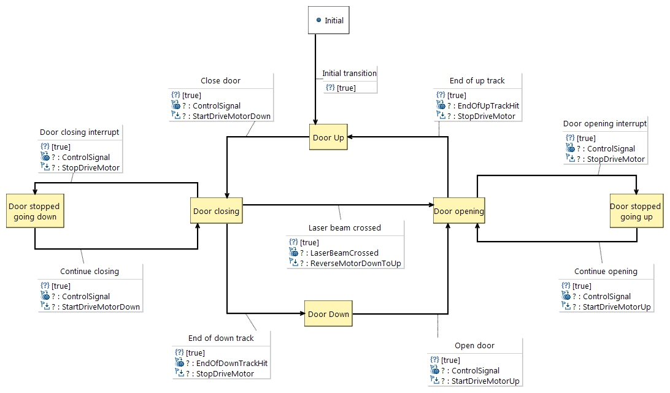
Garage Door Models
The Craft of Model-Based Testing

Slide 58
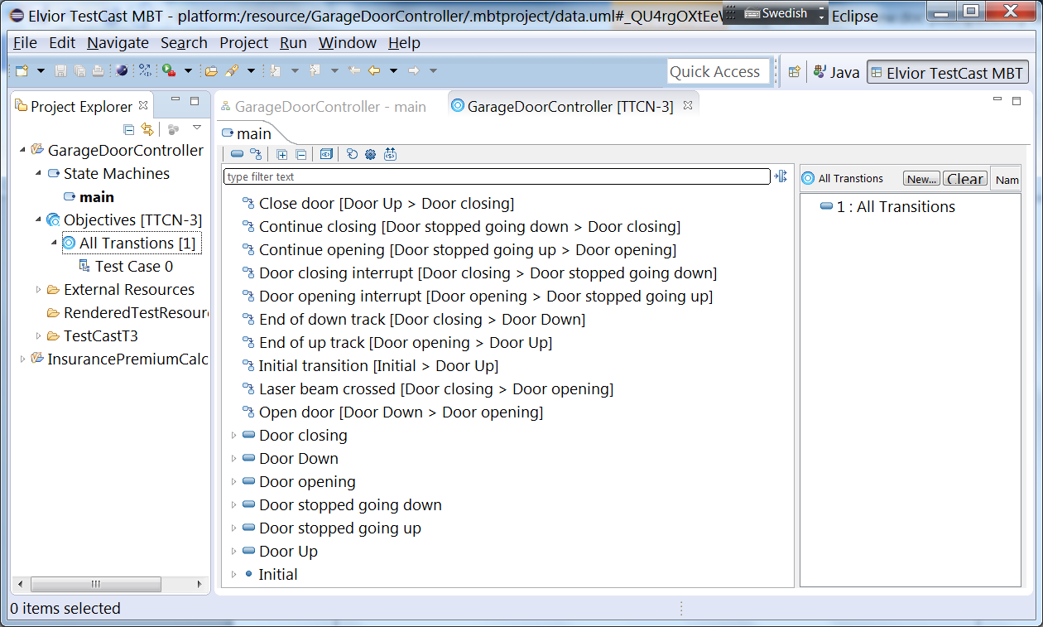
All Transitions Test Objective
The Craft of Model-Based Testing

Slide 59
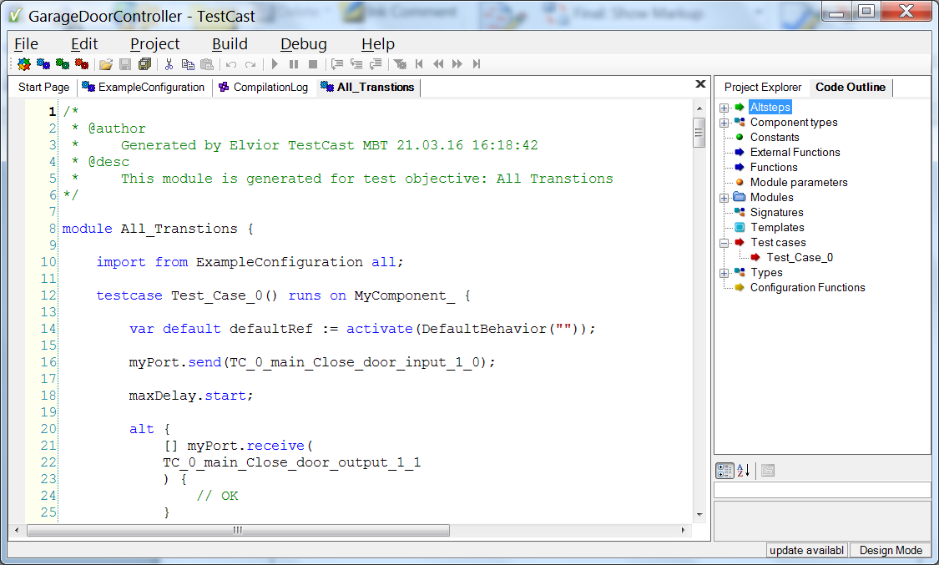
TTCN-3 Script
The Craft of Model-Based Testing

Slide 60
Vendor Advice
This tool requires basic knowledge of
  Eclipse - TestCast MBT frontend is Eclipse plugin
  TTCN-3 – external data definitions used on model are in TTCN-3
  UML – SUT behavior is modeled as UML state charts
The Craft of Model-Based Testing

Slide 61
5.5 sepp.med GmbH
sepp.med is a medium-sized, owner-managed company,
  specializes in IT solutions with integrated quality assurance in complex, safety-critical areas
  sepp.med has its headquarters near Nuremberg (Germany), other offices are located in Berlin, Wolfsburg and Ingolstadt.
Main product is MBTsuite
  automatically generates executable test cases and test data from graphical models
  generated test cases and/or test scripts may in turn be transferred to an existing test management tool.
Company website is www.mbtsuite.com
The Craft of Model-Based Testing

Slide 62
5.5 sepp.med GmbH (continued)
test case generation strategies are:
  full path coverage
  random / stochastic test case selection
  scenario-based selection called Named Path (one test case) and Guided Path (possibly several test cases)
Test coverage filters
  requirements coverage
  node coverage
  edge coverage
  test step / verification point coverage
The Craft of Model-Based Testing

Slide 63
Insurance Premium Models
Requirement Key | Description
req_base_rate | The base rate is $600.
req_age_limits | People under age 16 or over 90 cannot be insured.
req_age_ranges | The following premium multiplication values for age ranges apply: Age ranges ageMultiplier 16 <= age < 25 x = 1.5 25 <= age < 65 x = 1.0 65 <= age <90 x = 1.2
req_fault_claims | The following premium penalty values at fault claims apply: “At Fault” claims in past 5 years claimsPenalty 0 $0 1 to 3 $100 4 to 10 $300
req_fault_claim_limit | Drivers with more than 10 at fault claims in the past five years cannot be insured.
req_non_drinker_reduction | The reduction for being a non-drinker is $75.
req_student_reduction | The reduction for being a good student is $50.
The Craft of Model-Based Testing

Slide 64
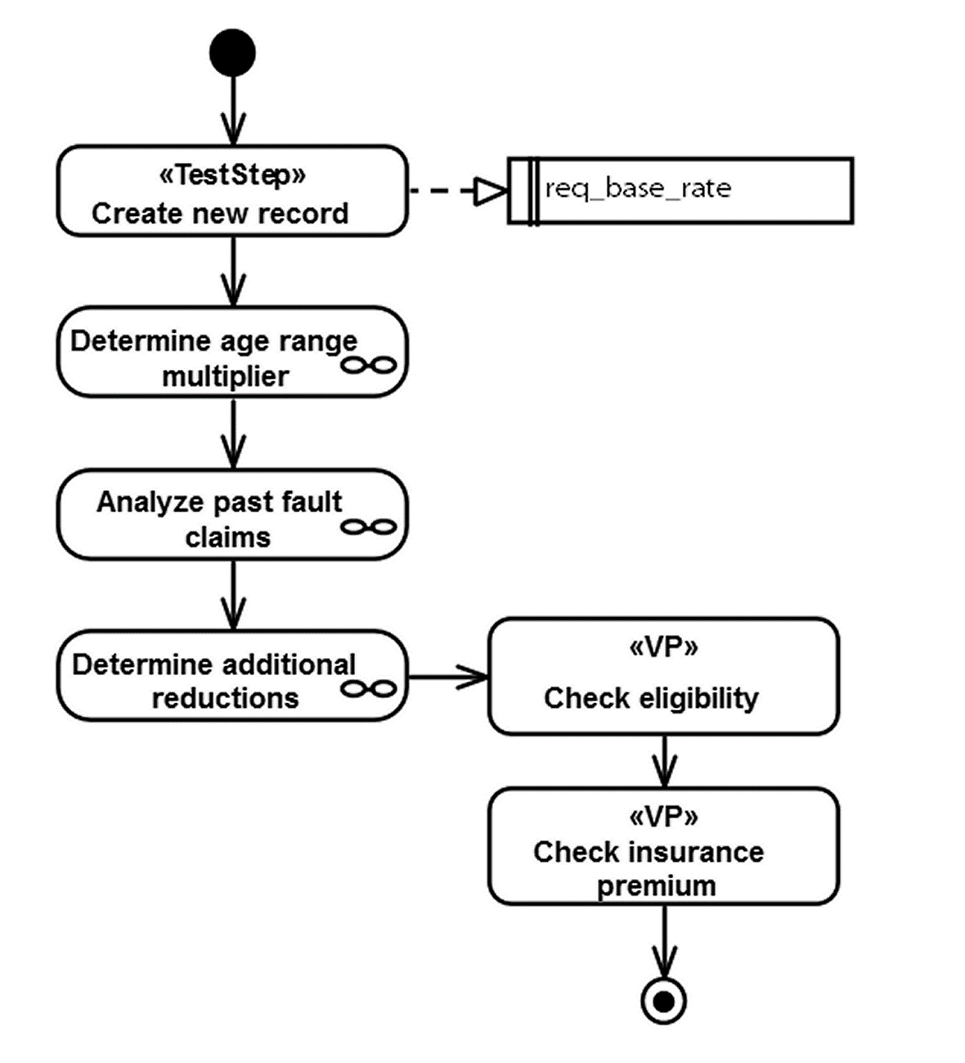
Insurance Premium Models (continued)
The Craft of Model-Based Testing

Slide 65
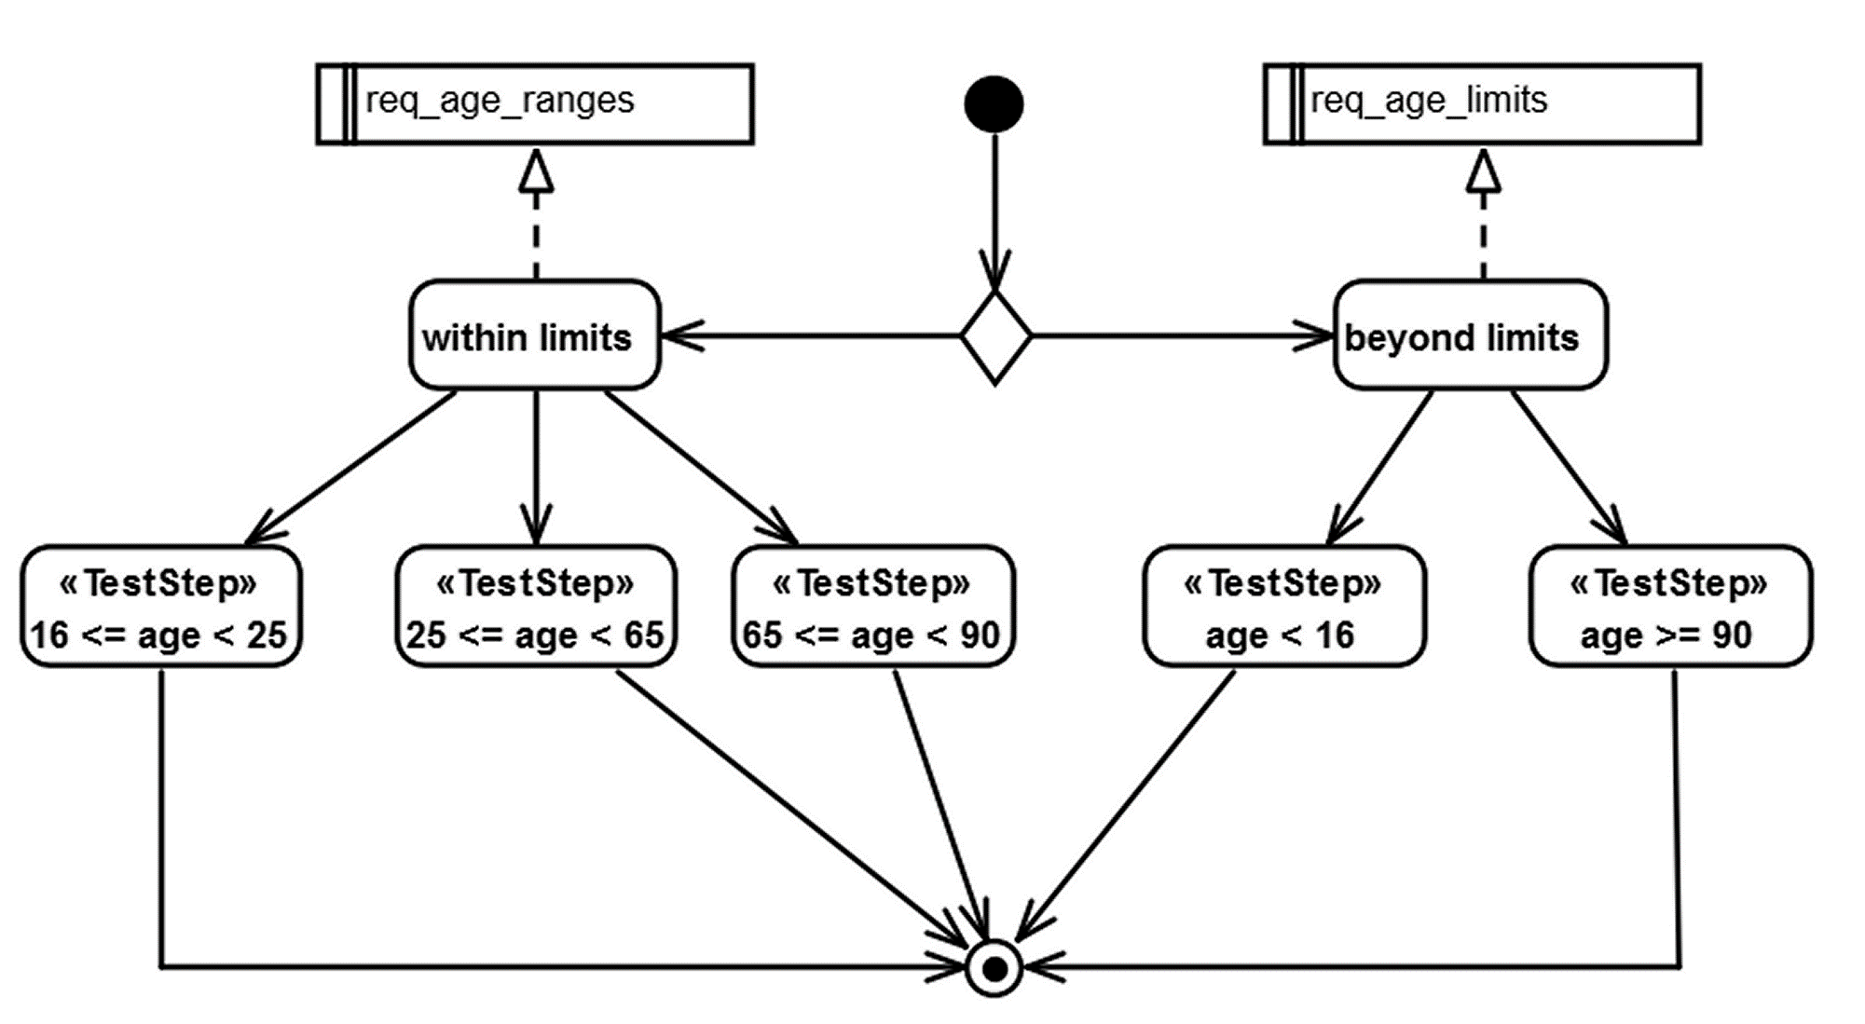
Insurance Premium Models (continued)
The Craft of Model-Based Testing

Slide 66
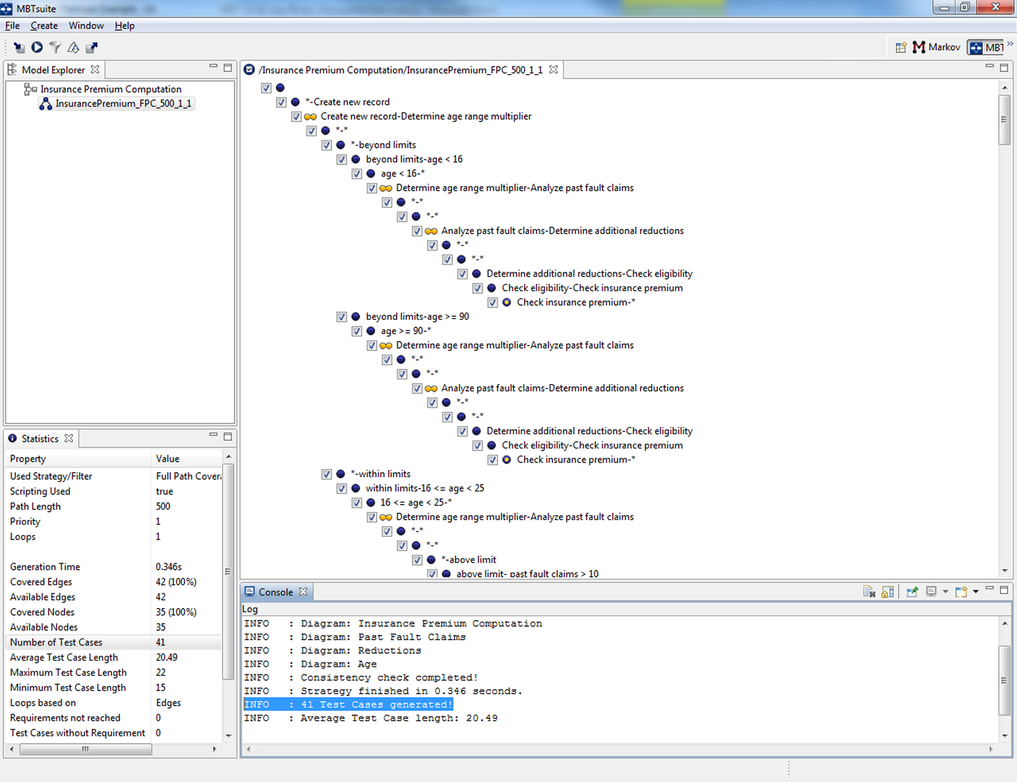
Insurance Premium Test Cases
41 test cases for full path coverage
The Craft of Model-Based Testing

Slide 67
Garage Door Models
Requirement Key | Description
req_close | When the door is fully open and a signal from the control device occurs, the door starts closing.
req_open | When the door is fully closed and a signal from the control device occurs, the door starts opening.
req_stop_manually | When the door is in motion, either closing or opening, and a signal from the control device occurs, the door stops.
req_resume | A subsequent control signal starts the door in the same direction as when it was stopped.
req_stop_end_of_up | When the door has moved to the extreme upper position (fully open), and a signal from the End of Up track occurs, the door stops.
req_stop_end_of_down | When the door has moved to the extreme lower position (fully closed), and a signal from the End of Down track occurs, the door stops.
hz_reverse | While the door is closing, if either the light beam is interrupted (possibly by a pet) or if the door encounters an obstacle, the door immediately stops, and then reverses direction.
The Craft of Model-Based Testing

Slide 68
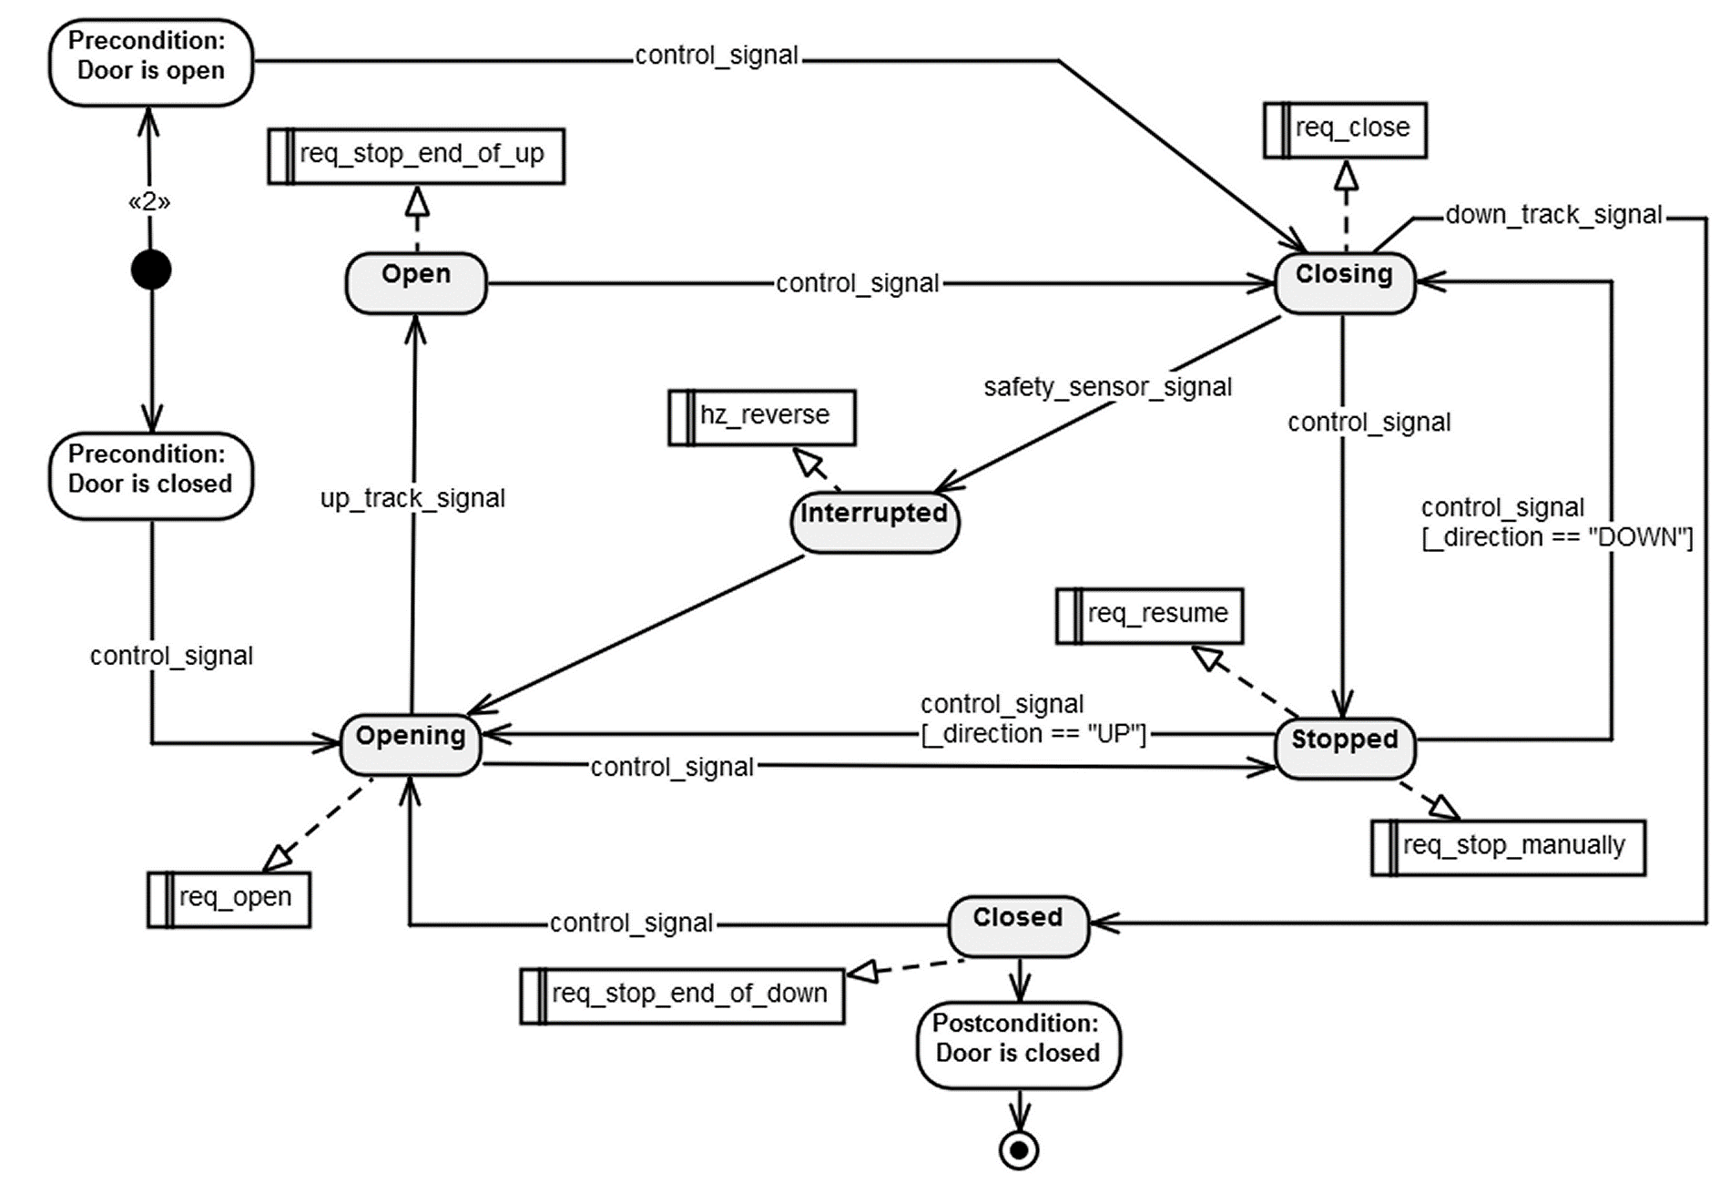
Garage Door FSM
The Craft of Model-Based Testing

Slide 69
Garage Door Test Cases
300 test cases for full path coverage
  Loop depth = 1
  Reduced to 81 with a “weight filter” (relative importance)
Partial sample test case first 6 of 34 steps)
The Craft of Model-Based Testing
Step | Type | Step Name | Step Description | Expected Result | Requirements
1 | Test Step |  | Send control device signal.
2 | Verification Point | Closing | Check, whether the door is closing. | The door is closing. | req_close
3 | Test Step |  | Send control device signal.
4 | Verification Point | Stopped | Check, whether the door has stopped. | The door has stopped. | req_stop_manually req_resume
5 | Test Step |  | Send control device signal.
6 | Verification Point | Closing | Check, whether the door is closing. | The door is closing. | req_close

Slide 70
5.6 Verified Systems International GmbH
Verified Systems International GmbH was established in 1998 as a spinoff company of the University of Bremen
The company specializes in
  verification and validation of safety-critical and
  business-critical embedded systems
  cyber-physical systems
Main product is the RT-Tester test automation and analysis tool box
Company website is https://www.verified.de
The Craft of Model-Based Testing

Slide 71
5.6 Verified Systems International GmbH
RT-MBT supports automatic generation of
  abstract test cases,
  concrete test cases, and
  test procedures
All derived from SysUML diagrams
The Craft of Model-Based Testing

Slide 72
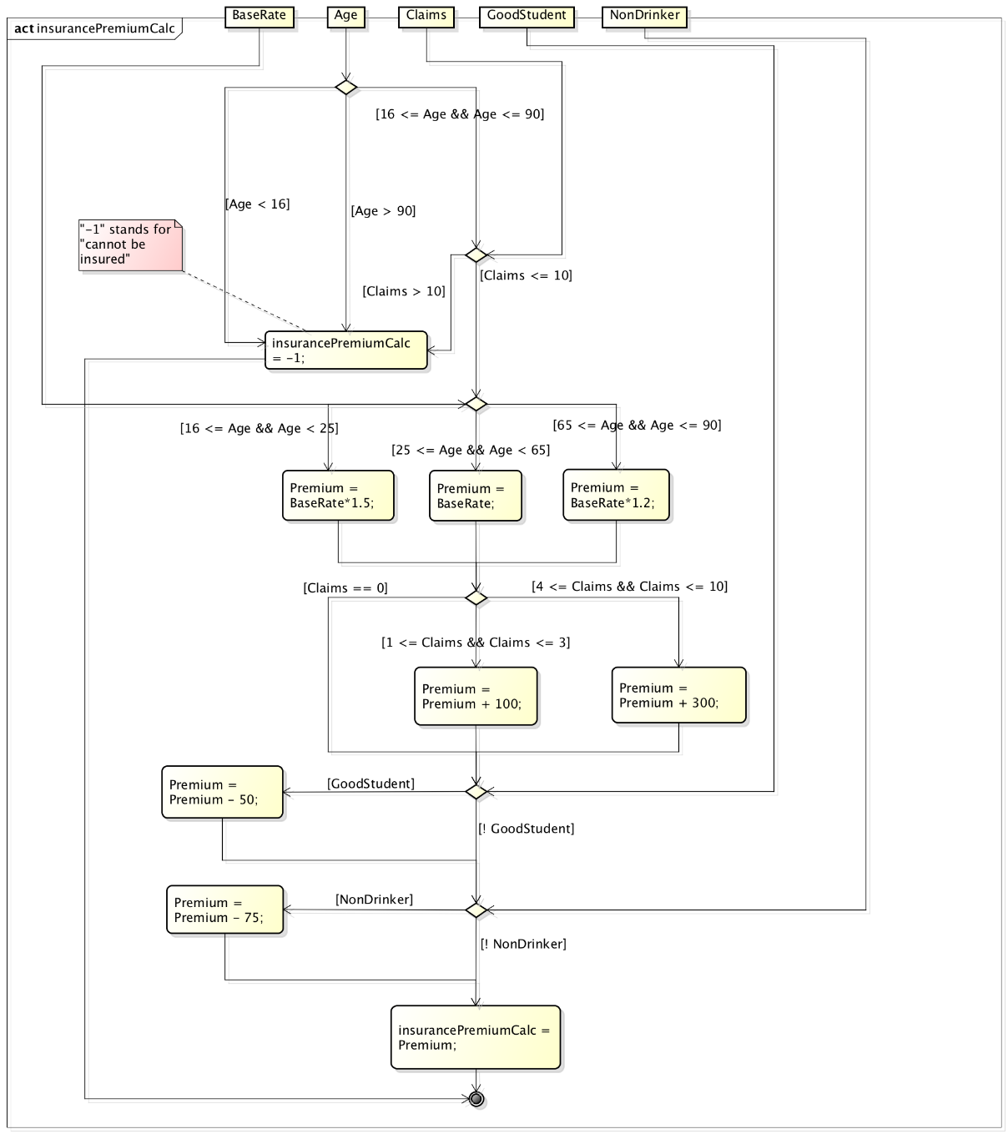
Insurance Premium Activity Diagram
The Craft of Model-Based Testing

Slide 73
Insurance Premium Input Equivalence classes
Input equivalence class examples
  (Age < 16) || (Age > 90) || (Claims > 10)
  (16 <= Age) && (Age < 25) && (1 <= Claims) && (Claims <= 3) && !GoodStudent && NonDrinker
Selecting 10 input vectors for each class results in 370 test cases
For this example, RT-MBT generated 10,000 test cases
The Craft of Model-Based Testing

Slide 74
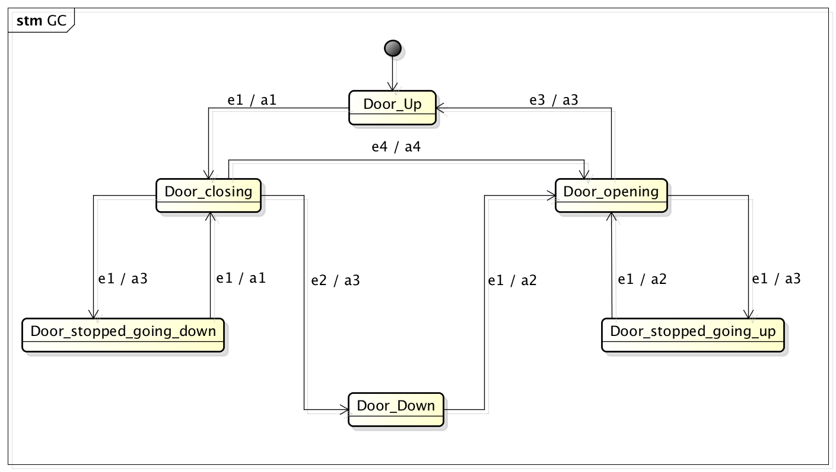
Garage Door Models
The Craft of Model-Based Testing

Slide 75
Garage Door Test Cases
Strategies for generating test cases
  Each state
  Each transition
  Requirements coverage
Maximal state coverage generates 252 test cases
A few examples
  1. (e1/a1).(e2/a3).(e1/a2).(e1/a3).(e1/a2).(e1/a3)
  2. (e1/a1).(e2/a3).(e1/a2).(e1/a3).(e1/a2).(e2/-)
  160. (e1/a1).(e4/a4).(e4/-).(e4/-).(e2/-).(e1/a3)
  252. (e4/-).(e4/-).(e4/-).(e1/a1)
The Craft of Model-Based Testing

Slide 76
Vendor Advice
Introducing MBT success requires
  The “conventional” verification and validation workflow needed to be adapted, and
  Test engineers developing test models need higher skills than engineers programming test procedures
The Craft of Model-Based Testing

Slide 77
Nun kommt alles zu Ende allhier:
Feder, Tinte, Tobak und auch wir.
Zum letzten Mal wird eingetunkt,
dann kommt der große schwarze Punkt.
The Craft of Model-Based Testing
Everything comes to an end here:
The Quill, ink, tobacco, and we also.
The quill is dipped for the last time,
Then comes the big, black period.

